Slide 1

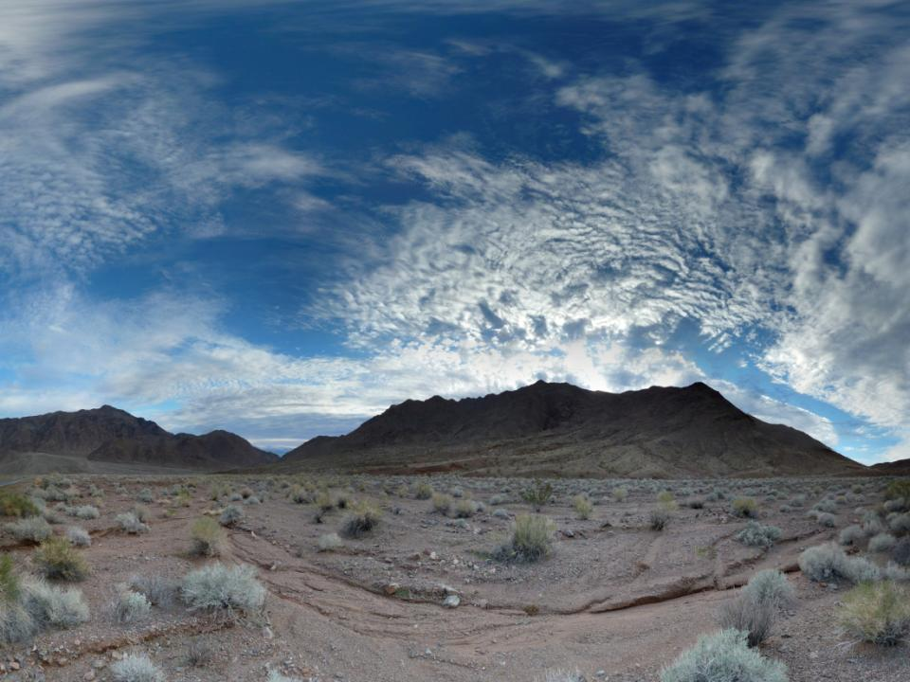
Overview of Mapping Threats to Wilderness Character
FS WWSR Monthly Call
August 2017
Peter Landres and James Tricker
Aldo Leopold Wilderness Research Institute
USDA Forest Service, Missoula, MT

Slide 2
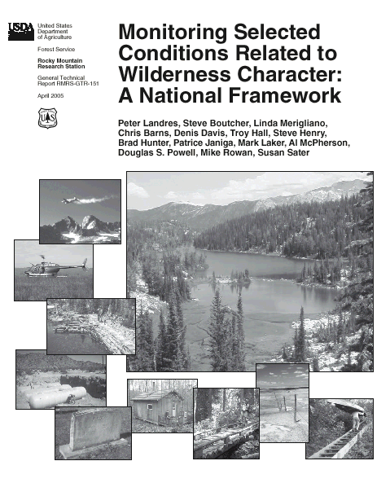
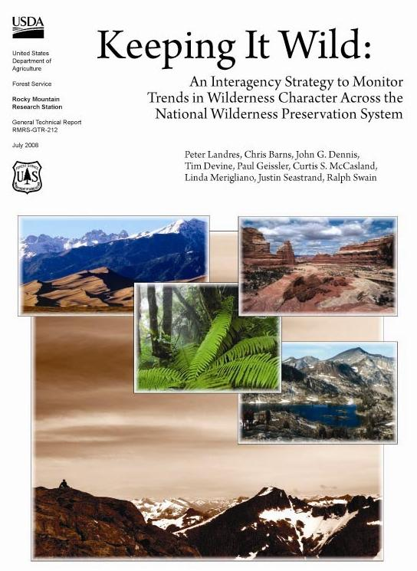
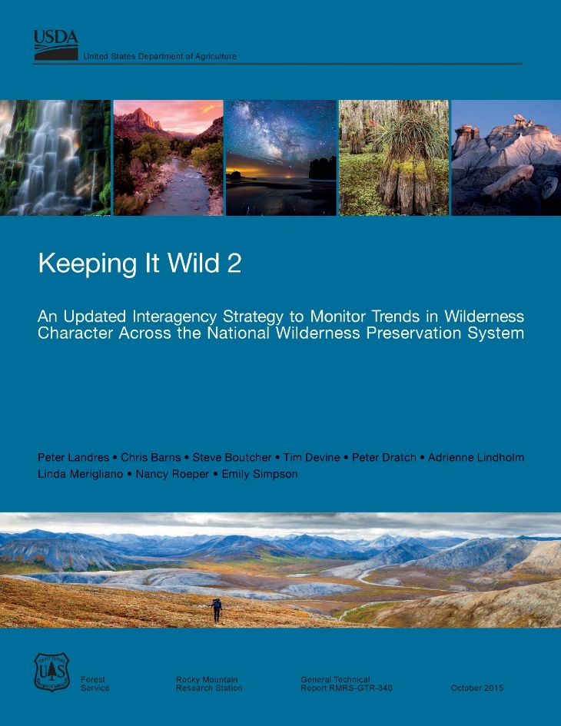
Wilderness Character
Wilderness Act of 1964
Wilderness Character
Section 2(c) Definition of Wilderness
Qualities
of Wilderness Character
Tangible, practical
Link management actions directly to the language of law and policy
Apply to EVERY wilderness and agency
Notes:
Developed by interagency team of wilderness experts to monitor trends in wilderness character (Note: KIW has been recently updated)
This monitoring strategy provides information for improving on-the-ground wilderness stewardship, policy review, and implementation based
on credible data that are consistently collected and endure over time as personnel change.
This in turn provides accountability for the legal and policy mandates “to preserve wilderness character” that apply to all four wilderness management agencies
Allows any agency wilderness to:
choose a set of measures from those provided in this document that are relevant, cost-effective, and tied to preserving wilderness character
periodically collect data to assess trend in these measures
use these trends to assess and report on the trend in wilderness character

Slide 3
Wilderness Character
“Untrammeled” — essentially unhindered and free from the intentional actions of modern human control or manipulation
“Natural” — ecological systems are substantially free from the effects of modern civilization
“Undeveloped” — essentially without permanent improvements or the sights and sounds of modern human occupation
“Solitude or Primitive and Unconfined Recreation” — outstanding opportunities for solitude, primitive and unconfined recreation, challenge, self-discovery, and inspiration
“Other Features of Value” — tangible features that are integral to the scientific, scenic, educational, conservation, or historical value of the wilderness
Wilderness Act of 1964
Wilderness Character
Section 2(c) Definition of Wilderness
Qualities
of Wilderness Character
Tangible, practical
Link management actions directly to the language of law and policy
Apply to EVERY wilderness and agency
Notes:
Key message to convey:
Identify measures that degrade (or enhance) wilderness character.
Evaluate how these measures combine with others to depict the indicator and quality maps.

Slide 4
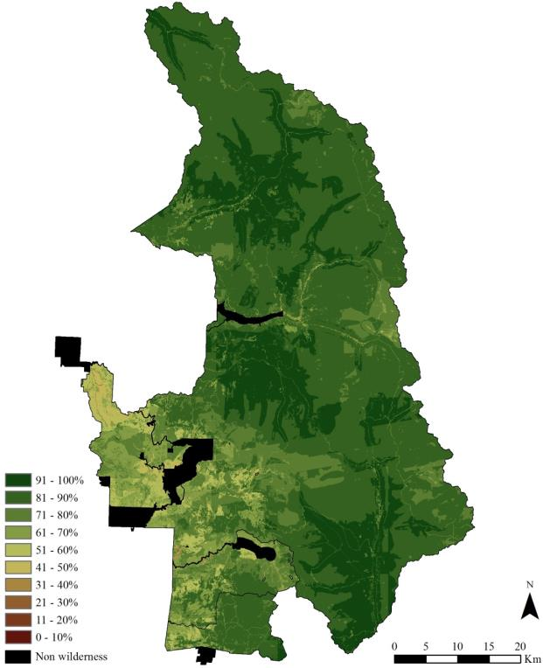
What is a map of
wilderness character?
A spatial representation of wilderness character
Shows where and what the condition of wilderness character is, based on the combination of indicators and qualities
Indicators and qualities taken directly from the KIW2 interagency framework
Sequoia-Kings Canyon Wilderness

Slide 5
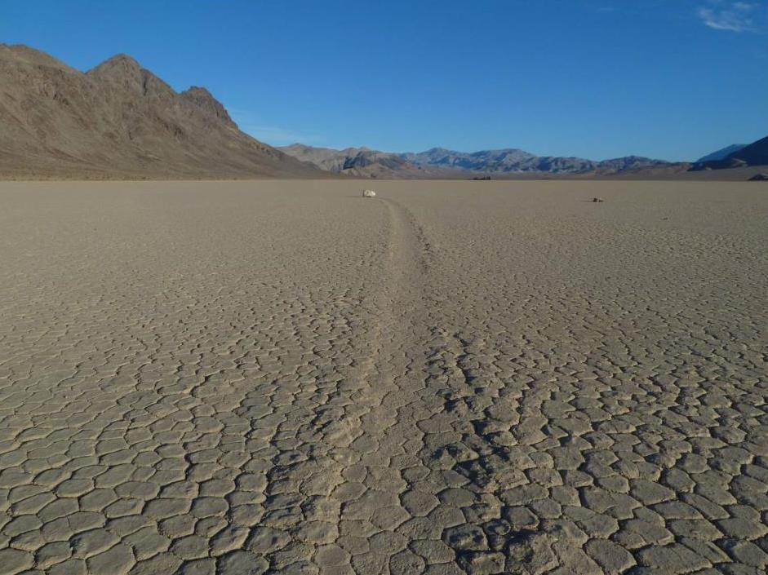
Why map wilderness character?
  Develop a spatially explicit understanding of wilderness character
  Establish a baseline for assessing change in where and how wilderness character is changing over time
  Evaluate potential impacts of proposed projects
  Evaluate outcomes of planning alternatives
  Show where improvements can be made

Slide 6
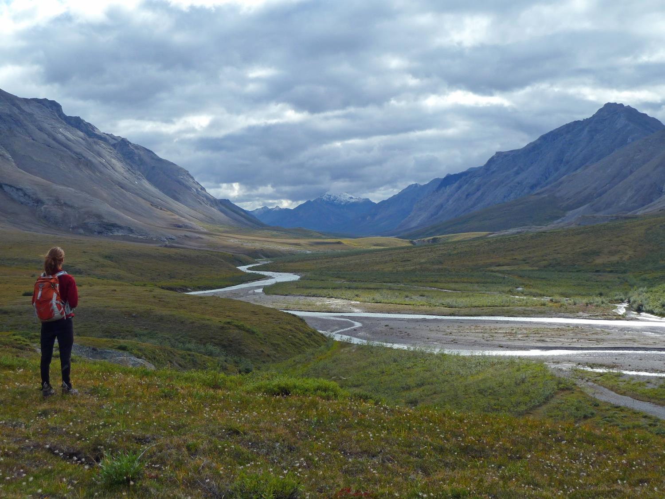
Cautions about
wilderness character mapping
Represents only certain aspects of wilderness character
  -- Does not show intangible, spiritual, or experiential aspects
Cannot be used to compare one wilderness to another
Should not be used to create sacrifice zones within the wilderness

Slide 7
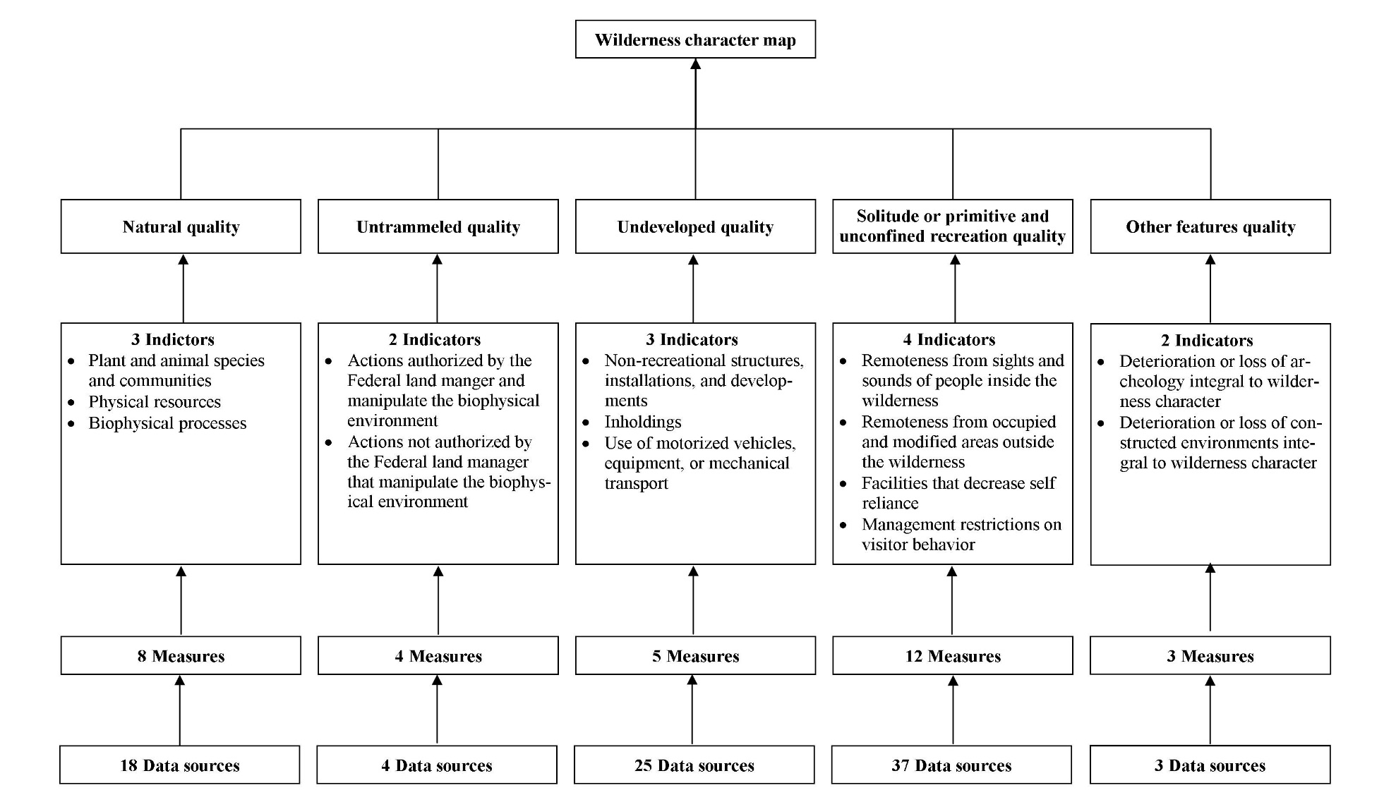
Mapping wilderness character
Nationally consistent
Locally relevant
Notes:
Wilderness character maps adhere to the interagency strategy for monitoring wilderness character, as described in Keeping It Wild 2: An Interagency Strategy for Monitoring Wilderness Character Across the National Wilderness Preservation System (Landres et al. 2015). Keeping It Wild 2 provides a tangible definition of wilderness character and identifies five qualities of wilderness character that apply uniquely to every wilderness: untrammeled, natural, undeveloped, solitude or primitive and unconfined recreation, and other features of value. These qualities apply to all designated wilderness areas because they are based on the legal definition of wilderness from the Wilderness Act (Section 2(c)). The five qualities of wilderness character form the foundation of the interagency monitoring strategy, and are the first level of the hierarchical monitoring framework. As described in Keeping It Wild 2, this framework divides wilderness character into successively finer components: the qualities of wilderness character are divided into a standard set of indicators , which are monitored in turn through a set of locally relevant measures . It is important that the project team understands the concept of wilderness character, and how the framework it provides is used to develop wilderness character maps

Slide 8
Data sources
National/local, vector/raster
Different scales, accuracy, completeness
Discrete (binary) vs continuous (range of values)
A number of data sets may inform one measure
Establish rules for combining these data sets
Notes:
National/local – wide array of scale
Vector/raster – different GIS formats
Discrete – presence of NNIS
Continuous – nightsky
Multiple datasets for one measure – UNDEV/Use of Motorized equipment/Authorized motorized/mechanized admin and state use
Includes: variety of overflights (moose - heli, wolf, international), motorized boat use, and ski trail grooming

Slide 9
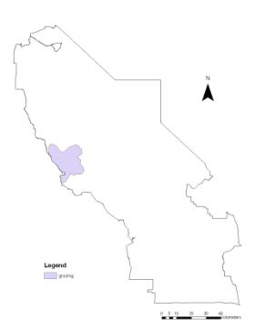
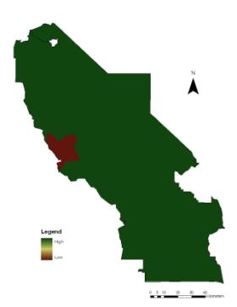
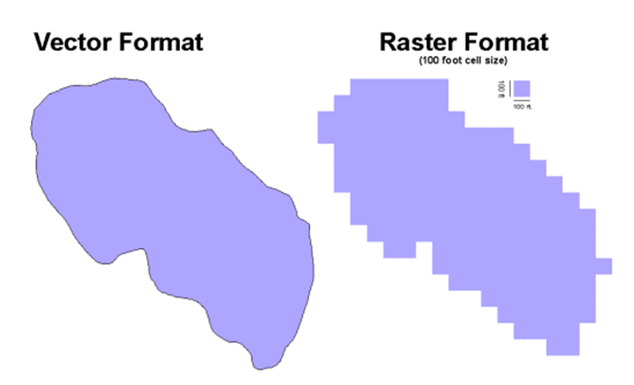
Processing – formatting
Majority of datasets are vector based: polygons, polylines and points.
Convert all to one data format - rasters (grids).
Normalize values (0-255) onto a common scale.
Permitted grazing area in Death Valley Wilderness
Normalized value and data layer for grazing area
Notes:
Majority of data are vector based: polygons, polylines and points.
Converted to rasters (grids) and normalize values (0-255) onto a common scale.
Eg is from DEVA – grandfathered grazing area on the westside of wilderness

Slide 10
Weighting measures
QUALITY | INDICATOR | MEASURE | WEIGHT
Natural | Plant and animal species & communities | Non-native invasive species - plants & animals | 6
 |  | Logging activity | 3
 |  | Extirpated Species | 2
 |  | Change in biodiversity | 2
 |  | Habituated bears | 1
 | Physical Resources | Soil erosion – recreation/maintenance related loss of soil | 6
 |  | Air quality - sulphur | 5
 |  | Air quality - nitrogen | 5
 |  | Dammed water | 2
 |  | Soil erosion - dam water levels affecting shoreline | 1
 | Biophysical processes | Departure from natural fire regimes | 8
 |  | Winter min temp | 2
 |  | Beaver removal | 2
Notes:
Once the measures have been created, the measures are combined into indicators using a weighting system.
The weights, which are decided by working group, are important because they acknowledge that certain measures are more detrimental/pervasive to WC than others.
Use eg from species and communities:
NNIS – important, Hab bears – less important
Can add weights to missing measures (for future use)
NOTE: the indictors in this example are from the original KIW.

Slide 11
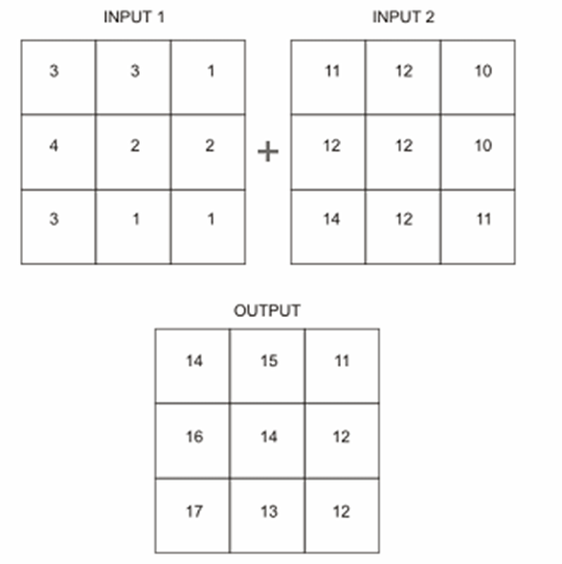
Processing – combining layers
INDICATOR | MEASURE | WEIGHT
Biophysical processes | Departure from natural fire regimes | 8
 | Winter min temp | 2
 | Beaver removal | 2
(Fire departure * 8) + (Winter temps * 2) + (Beaver removal * 2) = Biophysical Processes
Species & communities + Physical resources + Biophysical processes = Natural Quality
Natural + Untrammeled + Undeveloped + Solitude = Wilderness Character Map
Notes:
Example of combining layers: basic algebra

Slide 12
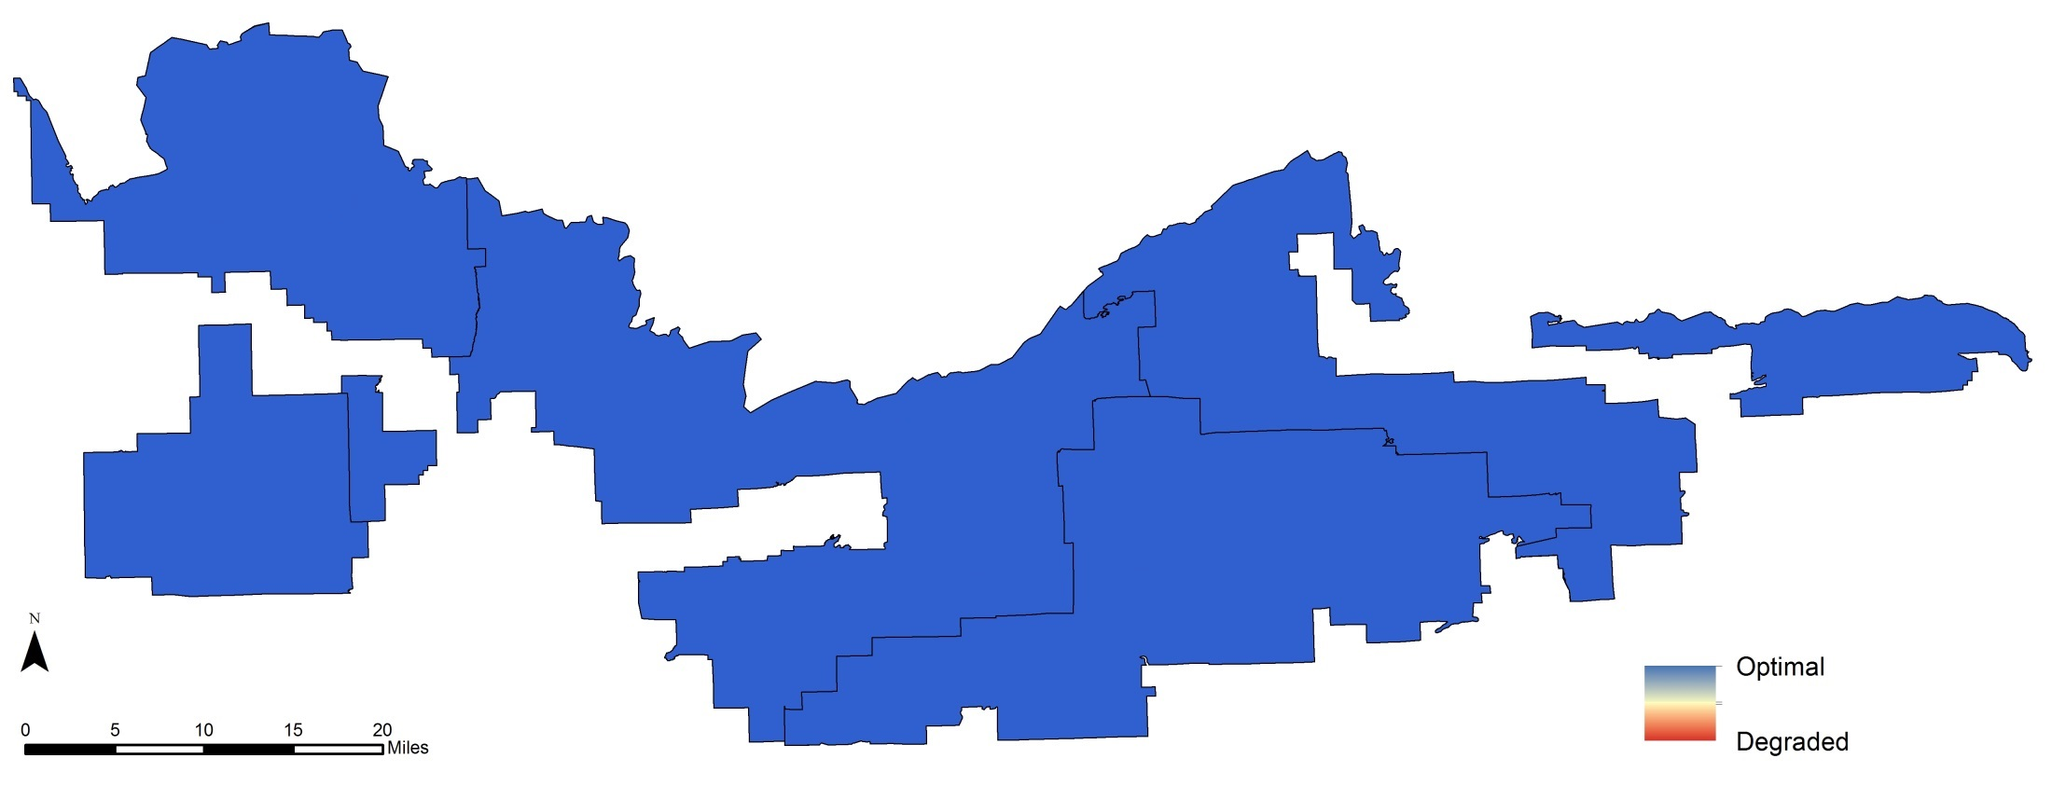
BWCAW, Natural - Soil Erosion
Notes:
Natural quality/physical resources/soil erosion – disturbance or loss of soil
Campsites within the BWCAW that contain greater than 800 square feet of exposed mineral soil.
This measure is one of a number of measures that were digitized from the District specialists’ hand drawn markings on maps. Like the other measures collected in this manner, this is information that, before this project, purely resided only in the local knowledge of the field specialists.

Slide 13
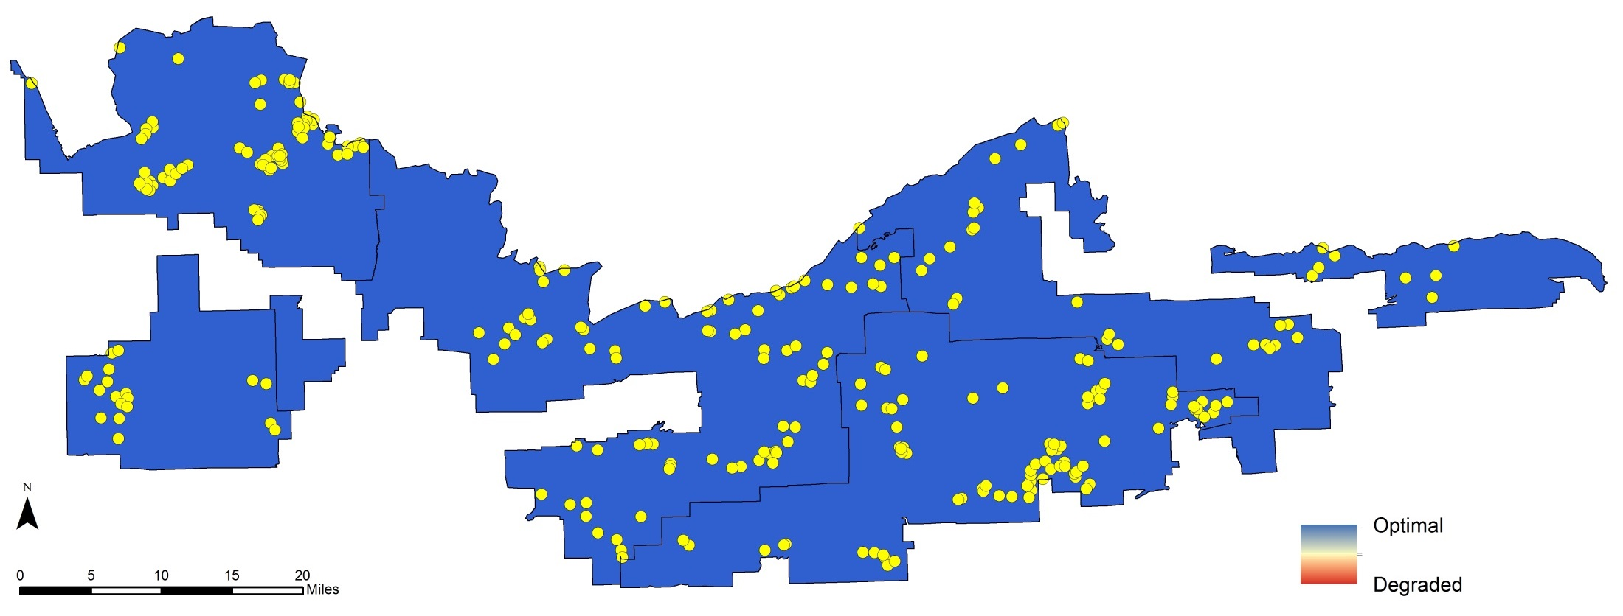
BWCAW, Natural - Soil Erosion
Notes:
Natural quality/physical resources/soil erosion – disturbance or loss of soil
This measure is one of a number of measures that were digitized from the District specialists’ hand drawn markings on maps. Like the other measures collected in this manner, this is information that, before this project, purely resided only in the local knowledge of the field specialists.

Slide 14

Untrammeled - Fire Suppression
Notes:
Untrammeled/Authorized actions/Fire suppression
The location of fire suppression efforts is another example of information that is not recorded for any purposes on the forest and resides only in local knowledge. There were 5 fires that we were not able to represent because the local knowledge is gone.
Size was not used to determine the suppression. We used local knowledge of each fire to determine the location of the suppression efforts. (I could have sworn I wrote metadata for this measure, but I cannot find it right now. I will make sure it is completed before we finish the report.)

Slide 15
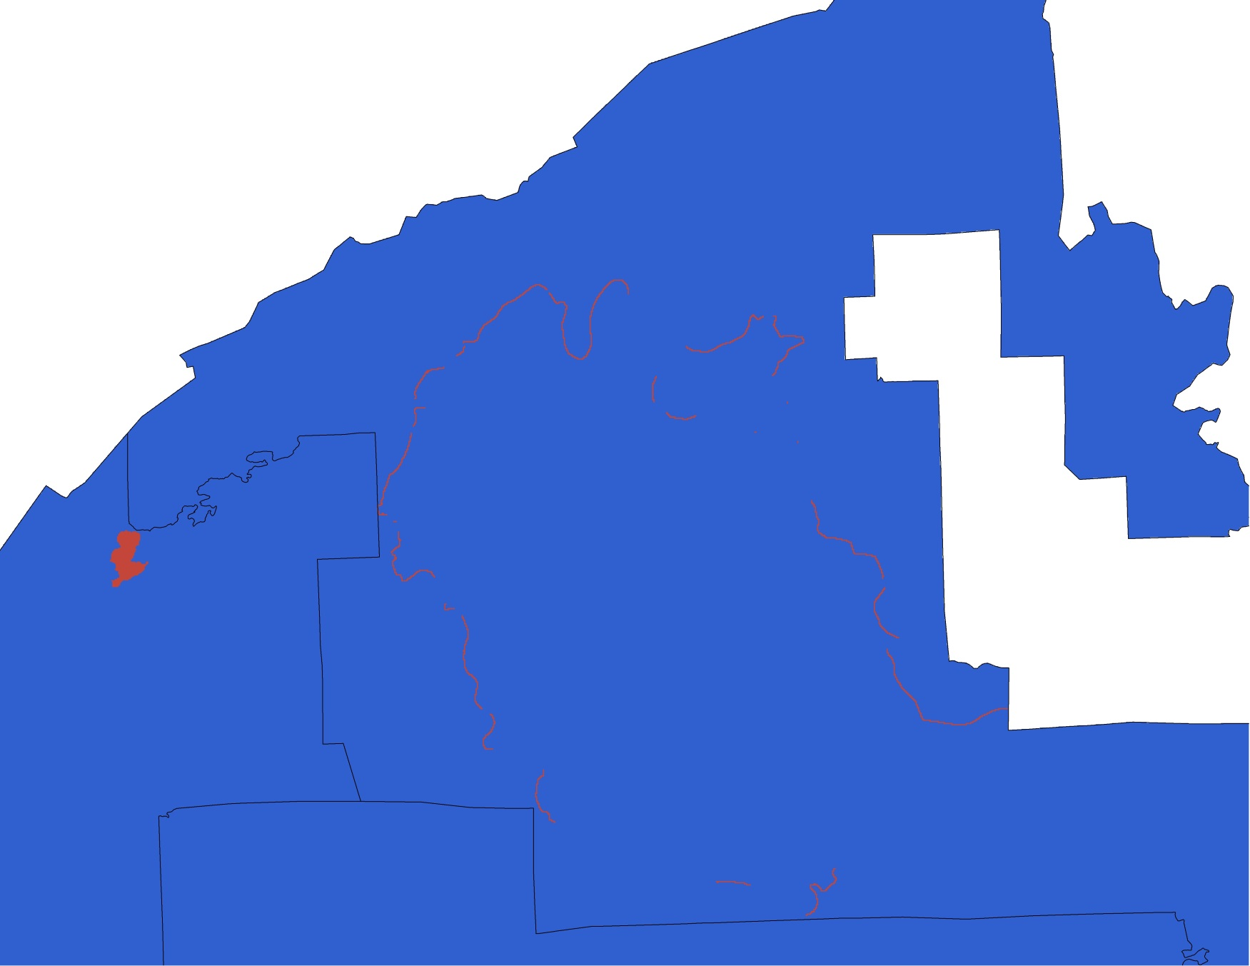
Untrammeled - Fire Suppression
Notes:
Suppression perimeter areas of the Ham Lake and Cavity fires, along with the whole area of the Knife Lake fire.
Cavity 2006 (31,568 acres) - Suppression on south, west, and north sides (hand line and water drops) * Breaks are where there is water/lakes
Ham 2007 (75,826 acres) - Suppression on North and south sides (hand line and water drops) *
Knife 2013 (188 acres) – whole area suppressed

Slide 16
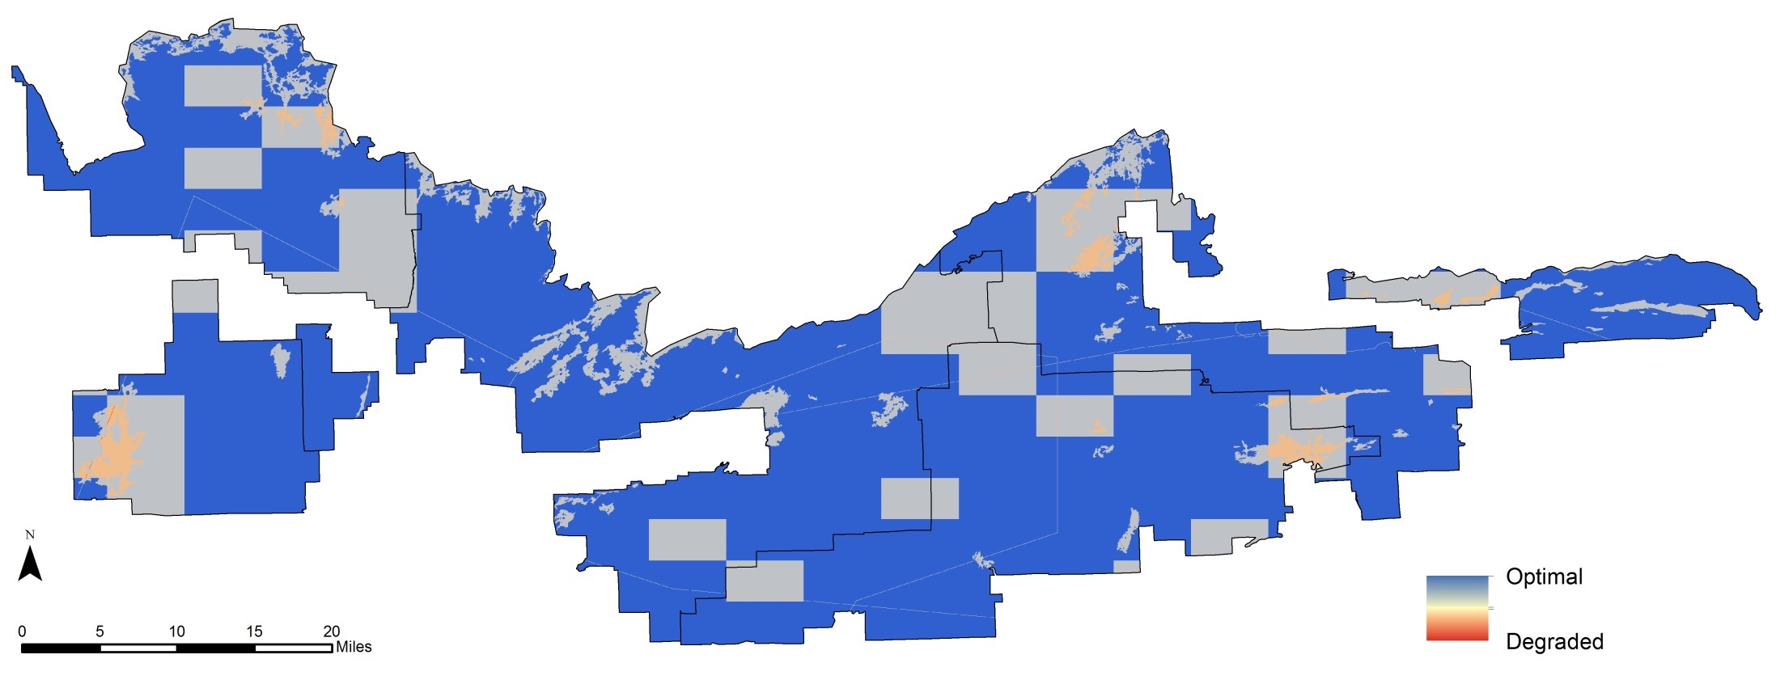
Undeveloped - Authorized Administrative Motorized/Mechanized Use
Comprised of the following inputs:
  Boat: fish survey
  Overflights: moose, fire, wolf, border, fish stocking
  Snowmobile: ski trail grooming

Slide 17

Solitude - Entry Point Congestion
Notes:
A 5 kilometer buffer within the wilderness from busy entry points. The 5k distance was determined by the core group at our meeting in September, 2014 and is based on visitor’s reported experiences of feeling stressed the first day. The buffer only includes the routes (lakes, portages/trails, streams) visitors take to arrive at campsites. Meant to represent the areas where visitors feel a “racing to a campsite” stress.

Slide 18
Death Valley Wilderness – Solitude Indicators
Remoteness from inside
Remoteness from outside
Facilities that decrease self-reliant recreation
Restrictions on visitor behavior

Slide 19
Death Valley Wilderness – Solitude Quality

Slide 20
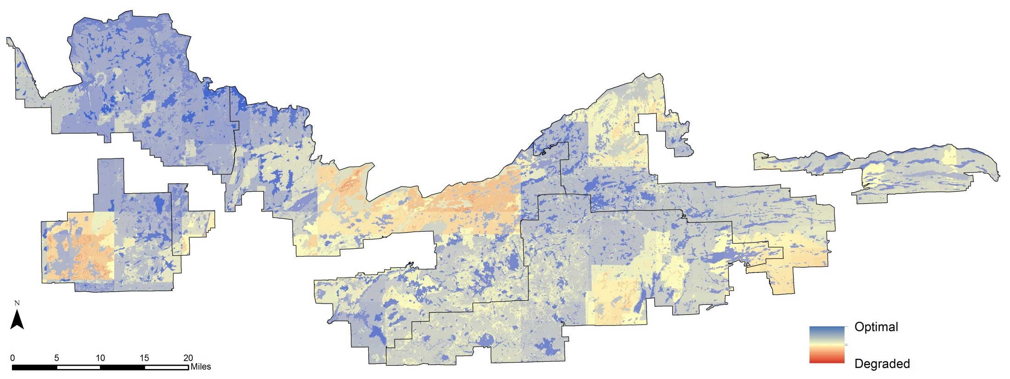
Natural quality
Plant and animal species & communities | Non-native invasive species - plants and animals | 6 | Physical resources | Soil erosion – loss of soil | 6 | Biophysical processes | Departure from natural fire regimes | 8
 | Logging activity | 3 |  | Air quality - sulphur | 5 |  | Change in winter temps | 2
 | Change in biodiversity | 2 |  | Air quality - nitrogen | 5 |  | Beaver removal | 2
 | Extirpated Species | 2 |  | Dammed water | 2
 | Habituated bears | 1 |  | Soil erosion - dam water levels | 1
Notes:
Talking points: campsites can have NNIS, erosion, habituated bears and beaver removal lakes, BW-wide values of extirpated species and temp changes.
Air quality – speaks to temporal nature of data – i.e. Pagami fire

Slide 21
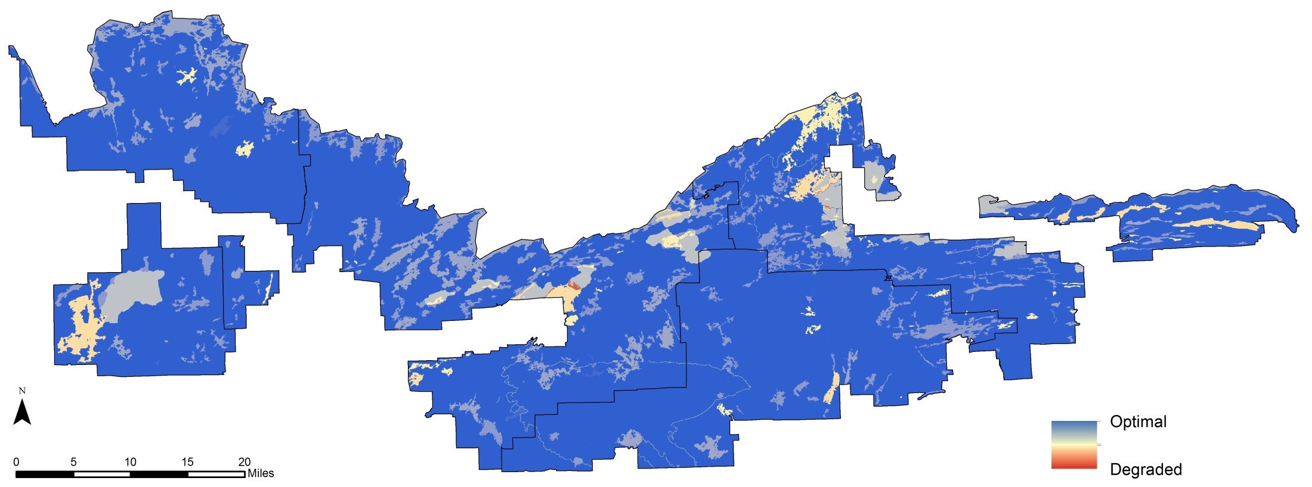
Untrammeled quality
Actions authorized by the Federal land manger that manipulate the biophysical environment | Fires suppressed | 10 | Dam water manipulation | 1 | Actions not authorized by the Federal land manager that manipulate the biophysical environment | Vandalism of natural resources | 2
 | Fish stocking | 8 | Animal manipulation | 1 |  | Poaching | 1
 | Prescribed fires | 8 | Disturbed/manipulated-lands facility maintenance | 1
 | Fish/lake survey | 5 | Fish spawn collection | 1
 | NNIS treatments | 2

Slide 22
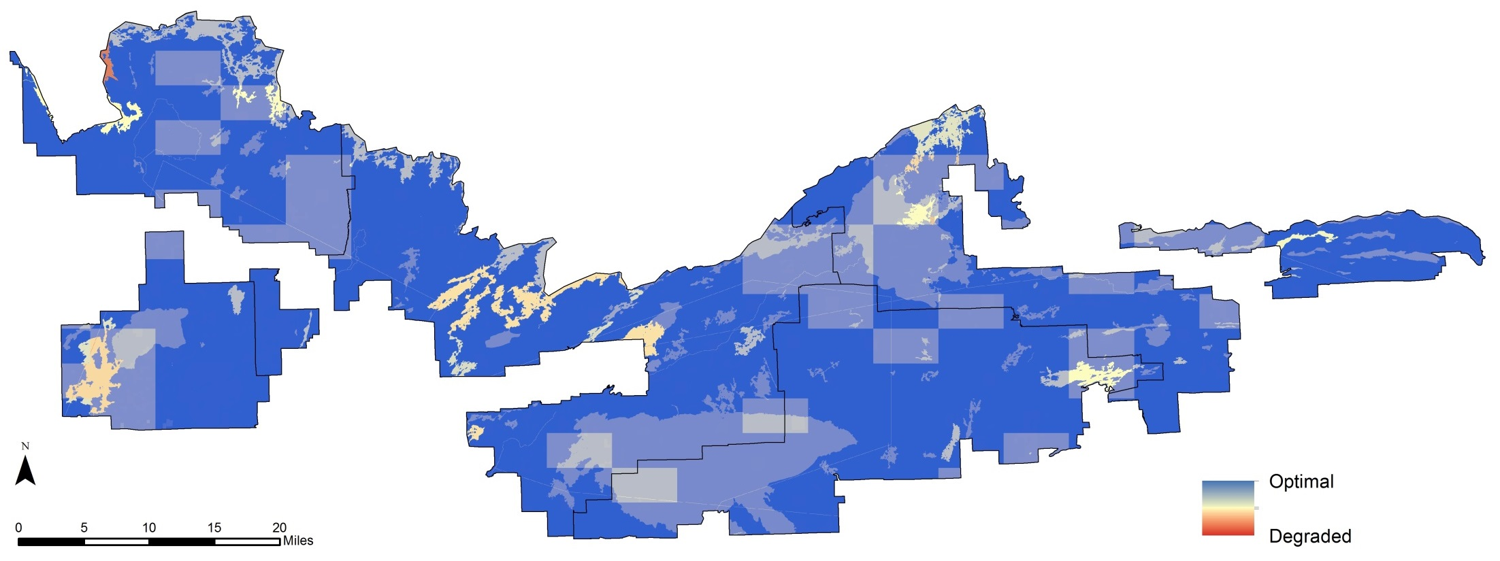
Undeveloped quality
Non-recreational structures, installations, and developments | Authorized physical developments | 3 | Inholdings | Developed inholdings | 3 | Use of motor vehicles, motorized equipment, or mechanical transport | Semi-primitive motorized/mechanized use | 10
 | Research | 1 |  | Infrastructure that supports inholdings | 2 |  | Authorized motorized/mechanized admin agency use | 10
 |  |  |  | Undeveloped inholdings | 1 |  | Emergency administrative use | 3
 |  |  |  |  |  |  | Unauthorized /Illegal Use | 1
Notes:
Moose helicopter flights

Slide 23
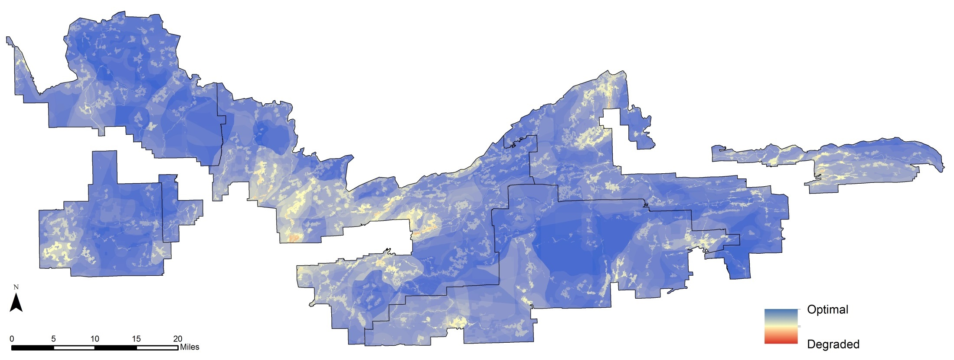
Solitude quality
Or Primitive & Unconfined Recreation
Remoteness from sights and sounds of people inside the wilderness | Crowding – Campsite occupancy | 8 | Remoteness from occupied and modified areas outside the wilderness | Entry point congestion | 5 | Facilities that decrease self-reliant recreation | FS Visitor facilities | 10
 | Sound - Administrative Motorized Use | 8 |  | Soundscape - Utilitarian | 3 |  | Trails and trail features | 7
 | Campsite sound | 6 |  | Viewshed - Outside | 3 |  | Mechanical/motorized portages and tow routes | 4
 | Viewshed - Inside | 5 |  | Night sky obfuscation | 3 |  | Wireless coverage | 2
 | Crowding - Encounters | 4 |  | Soundscape - recreation | 2 |  | User-created facilities | 1
 | Commercial outfitters | 4 |  |  |  | Management restrictions on visitor behavior | BW specific rules and regulations | 5
 | High use destinations & routes | 3
Notes:
Zoom in on beige travel routes of solitude map to show complexities in those zones – crowded zones, motor use, viewshed of facilities, high use, crowded routes, tow routes, mechanical portages, etc.

Slide 24
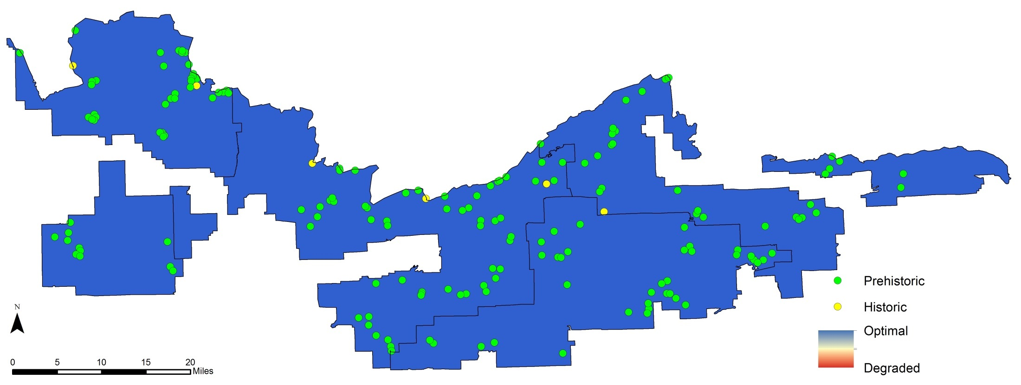
Other features of value
Heritage | Prehistoric features | 10
 | Historic features | 10
Notes:
SOURCES
Lee Johnson, Archaeologist, Superior National Forest – ExposedSoils_Heritage.shp
Not Eligible - heritage sites that have lost integrity due to visitor induced erosion/compaction
Unevaluated - heritage sites that are unevaluated to the National Register and are collocated with designated campsites exhibiting moderate/high visitor induced effects (erosion, compaction, mineral soil exposure, etc).
PROCESSING
The heritage program selected heritages sites that were collocated with the ExposedSoil.shp features (used for the Soil Loss measure of the Physical Resources indicator of the Natural quality showing the location of campsites with greater than 800 square feet of exposed soil).
CAUTIONS
The heritage resources point data will be used as a factor in the overall Wilderness Character value, but there will not be a map showing just the 5th Quality. In other words, a person will not be able to point to a specific location of the Wilderness Character Map and say that any value less than 100% optimal is in part due to the cultural resource points.
This point data may not be shared.
The information contained in these data is dynamic and may change over time. The data are not better than the original sources from which they were derived.

Slide 25
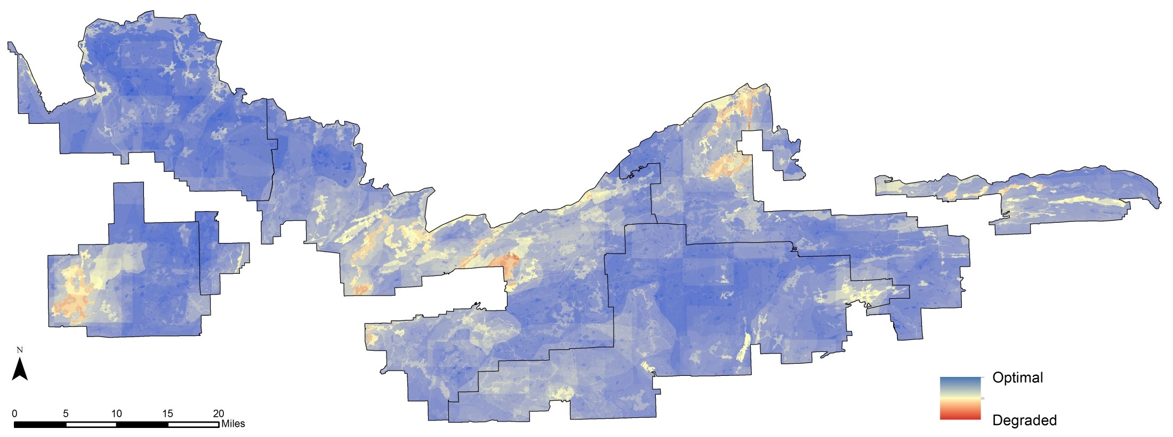
Wilderness character map
Natural + Untrammeled + Undeveloped + Solitude + Other features = Wilderness Character Map
Notes:
Degraded around Sag, Ely, west side of trout lake unit
Optimal around Tofte, LaCroix

Slide 26
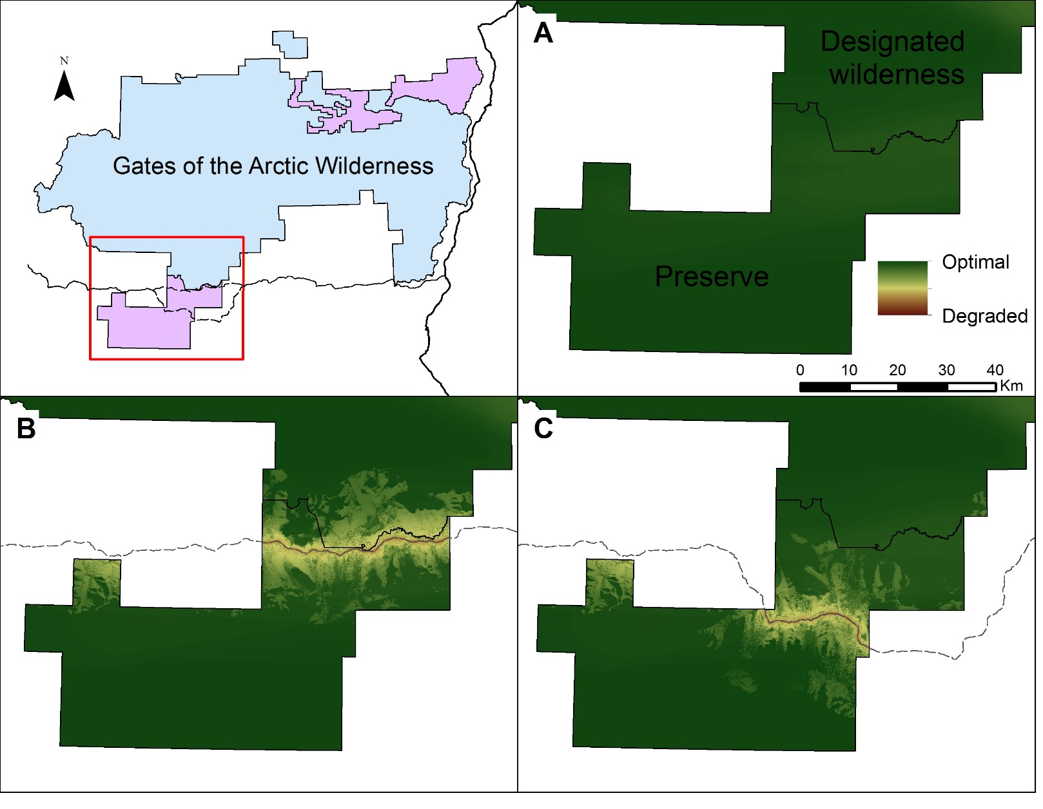
Using a map of wilderness character in project evaluation
Proposed
Road

Slide 27
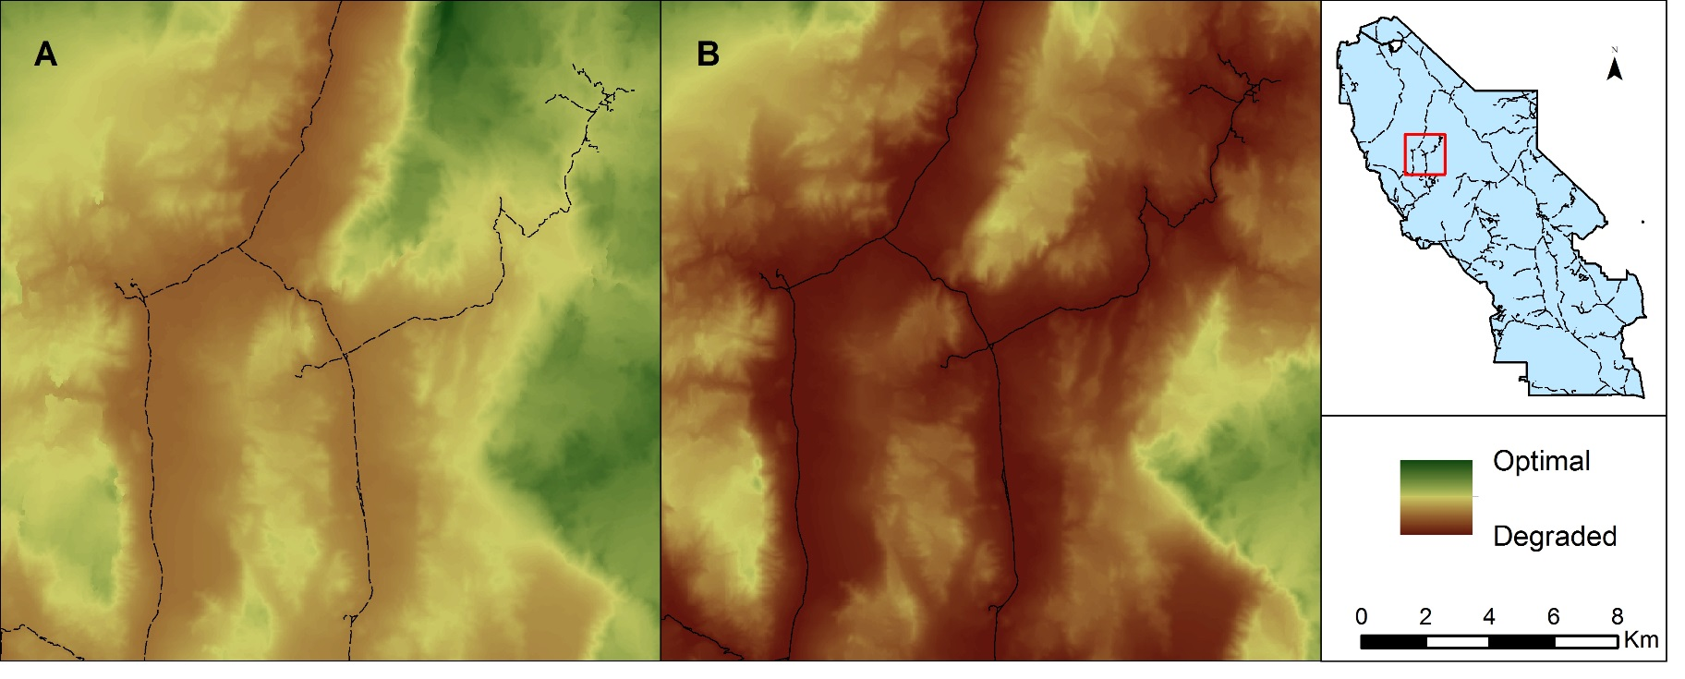
Using a map of wilderness character in wilderness planning

Slide 28
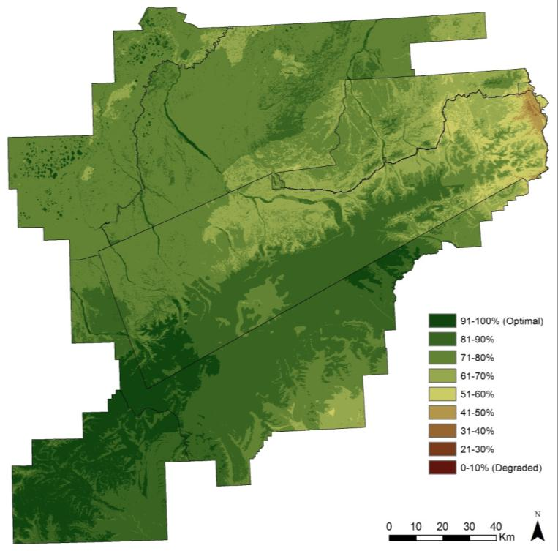
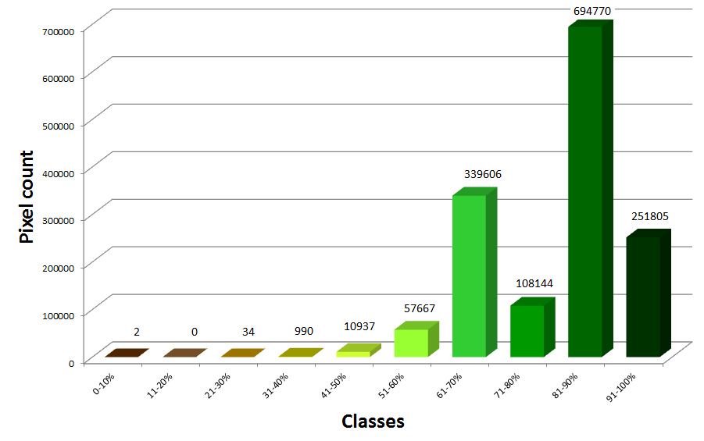
Using a map of wilderness character in wilderness planning
10 Categories
Histogram
Denali National Park and Preserve

Slide 29
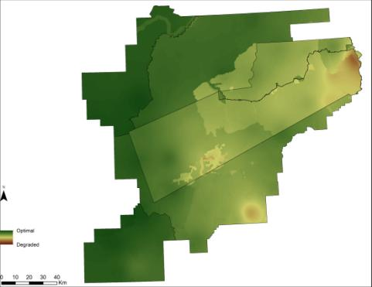

Limitations: Temporal change
Solitude quality in summer
Solitude quality in winter
Denali National Park and Preserve
Notes:
Some of the threats to wilderness character are highly temporal in nature. These may include overflights or adjacent motorized use that occur sporadically throughout the day, nightsky impacts that are only relevant during darkness or large shifts in visitation due to seasonality, particularly for Alaskan wildernesses. As a consequence, a worst-case scenario approach is adopted to capture the impacts of these measures; interpreting the maps requires the user to be mindful of this approach. This is particularly evident for measures depicting viewshed or soundscape impacts – the models that produce these data require features (such as a motor vehicle) to be “present” at all times in order to capture their associated impacts (when in reality very few vehicles may travel the road per day). Therefore, wilderness staff may choose to lower the weights for these temporal measures to reduce their overall influence on the wilderness character map.

Slide 30
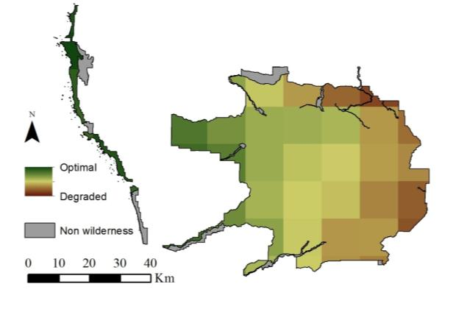
Limitations: Data
Air quality data for Olympic Wilderness
Data quality – varies considerably
Data gaps for important impacts
Data resolution
Notes:
Data quality – completeness & accuracy
Data gaps – change in fire regime, climate change impacts
Resolution issues – size of park, air quality grids

Slide 31
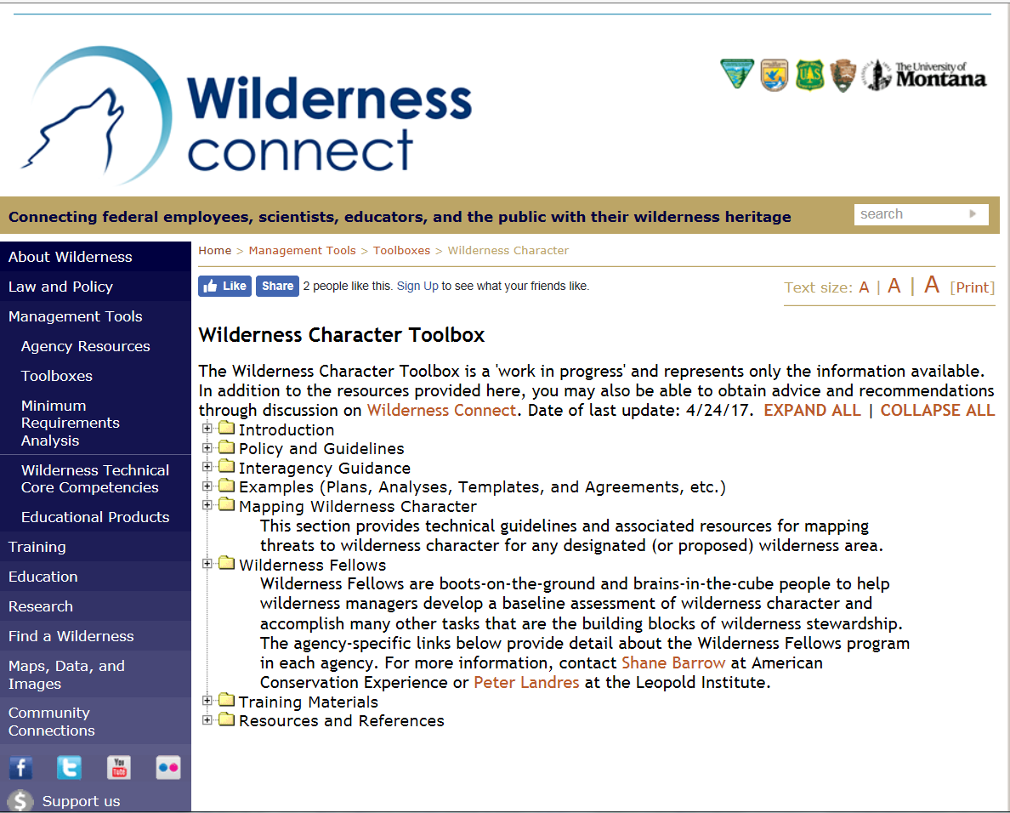
Tools and Resources
Notes:
Data quality – completeness & accuracy
Data gaps – change in fire regime, climate change impacts
Resolution issues – size of park, air quality grids

Slide 32
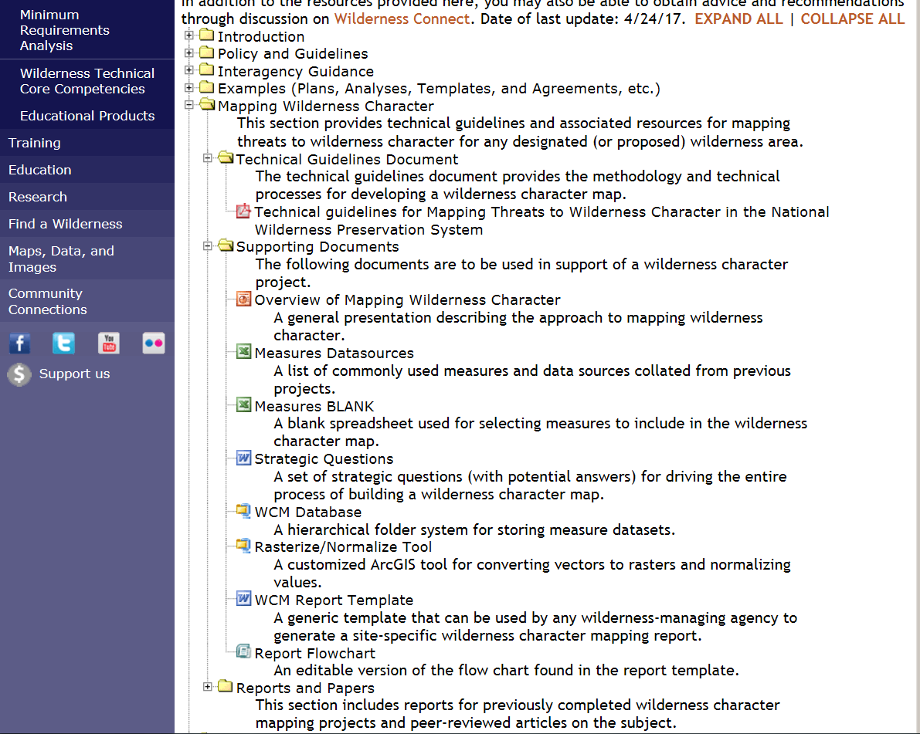
Tools and Resources
Notes:
Data quality – completeness & accuracy
Data gaps – change in fire regime, climate change impacts
Resolution issues – size of park, air quality grids

Slide 33
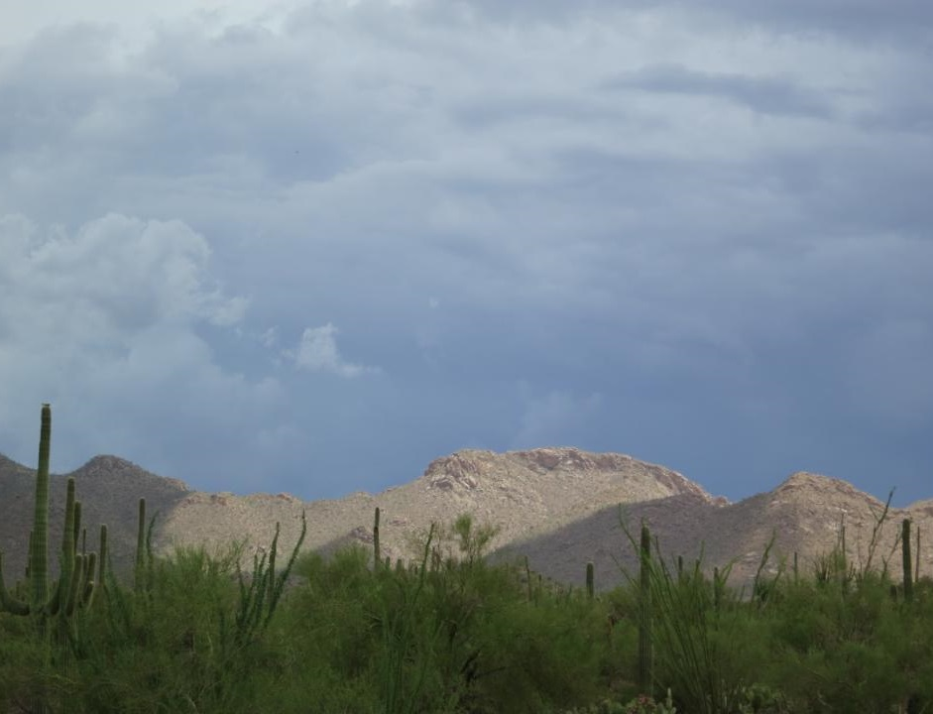
End game: Improve wilderness stewardship
  Standardized methods showing how wilderness character varies within a wilderness
  Establish spatially explicit baseline for assessing change over time
  Assess potential impacts of proposed projects, both inside and outside wilderness
  Assess potential consequences on wilderness character from different plan alternatives
  Help answer the question: How do we preserve wilderness character?

