Slide 1
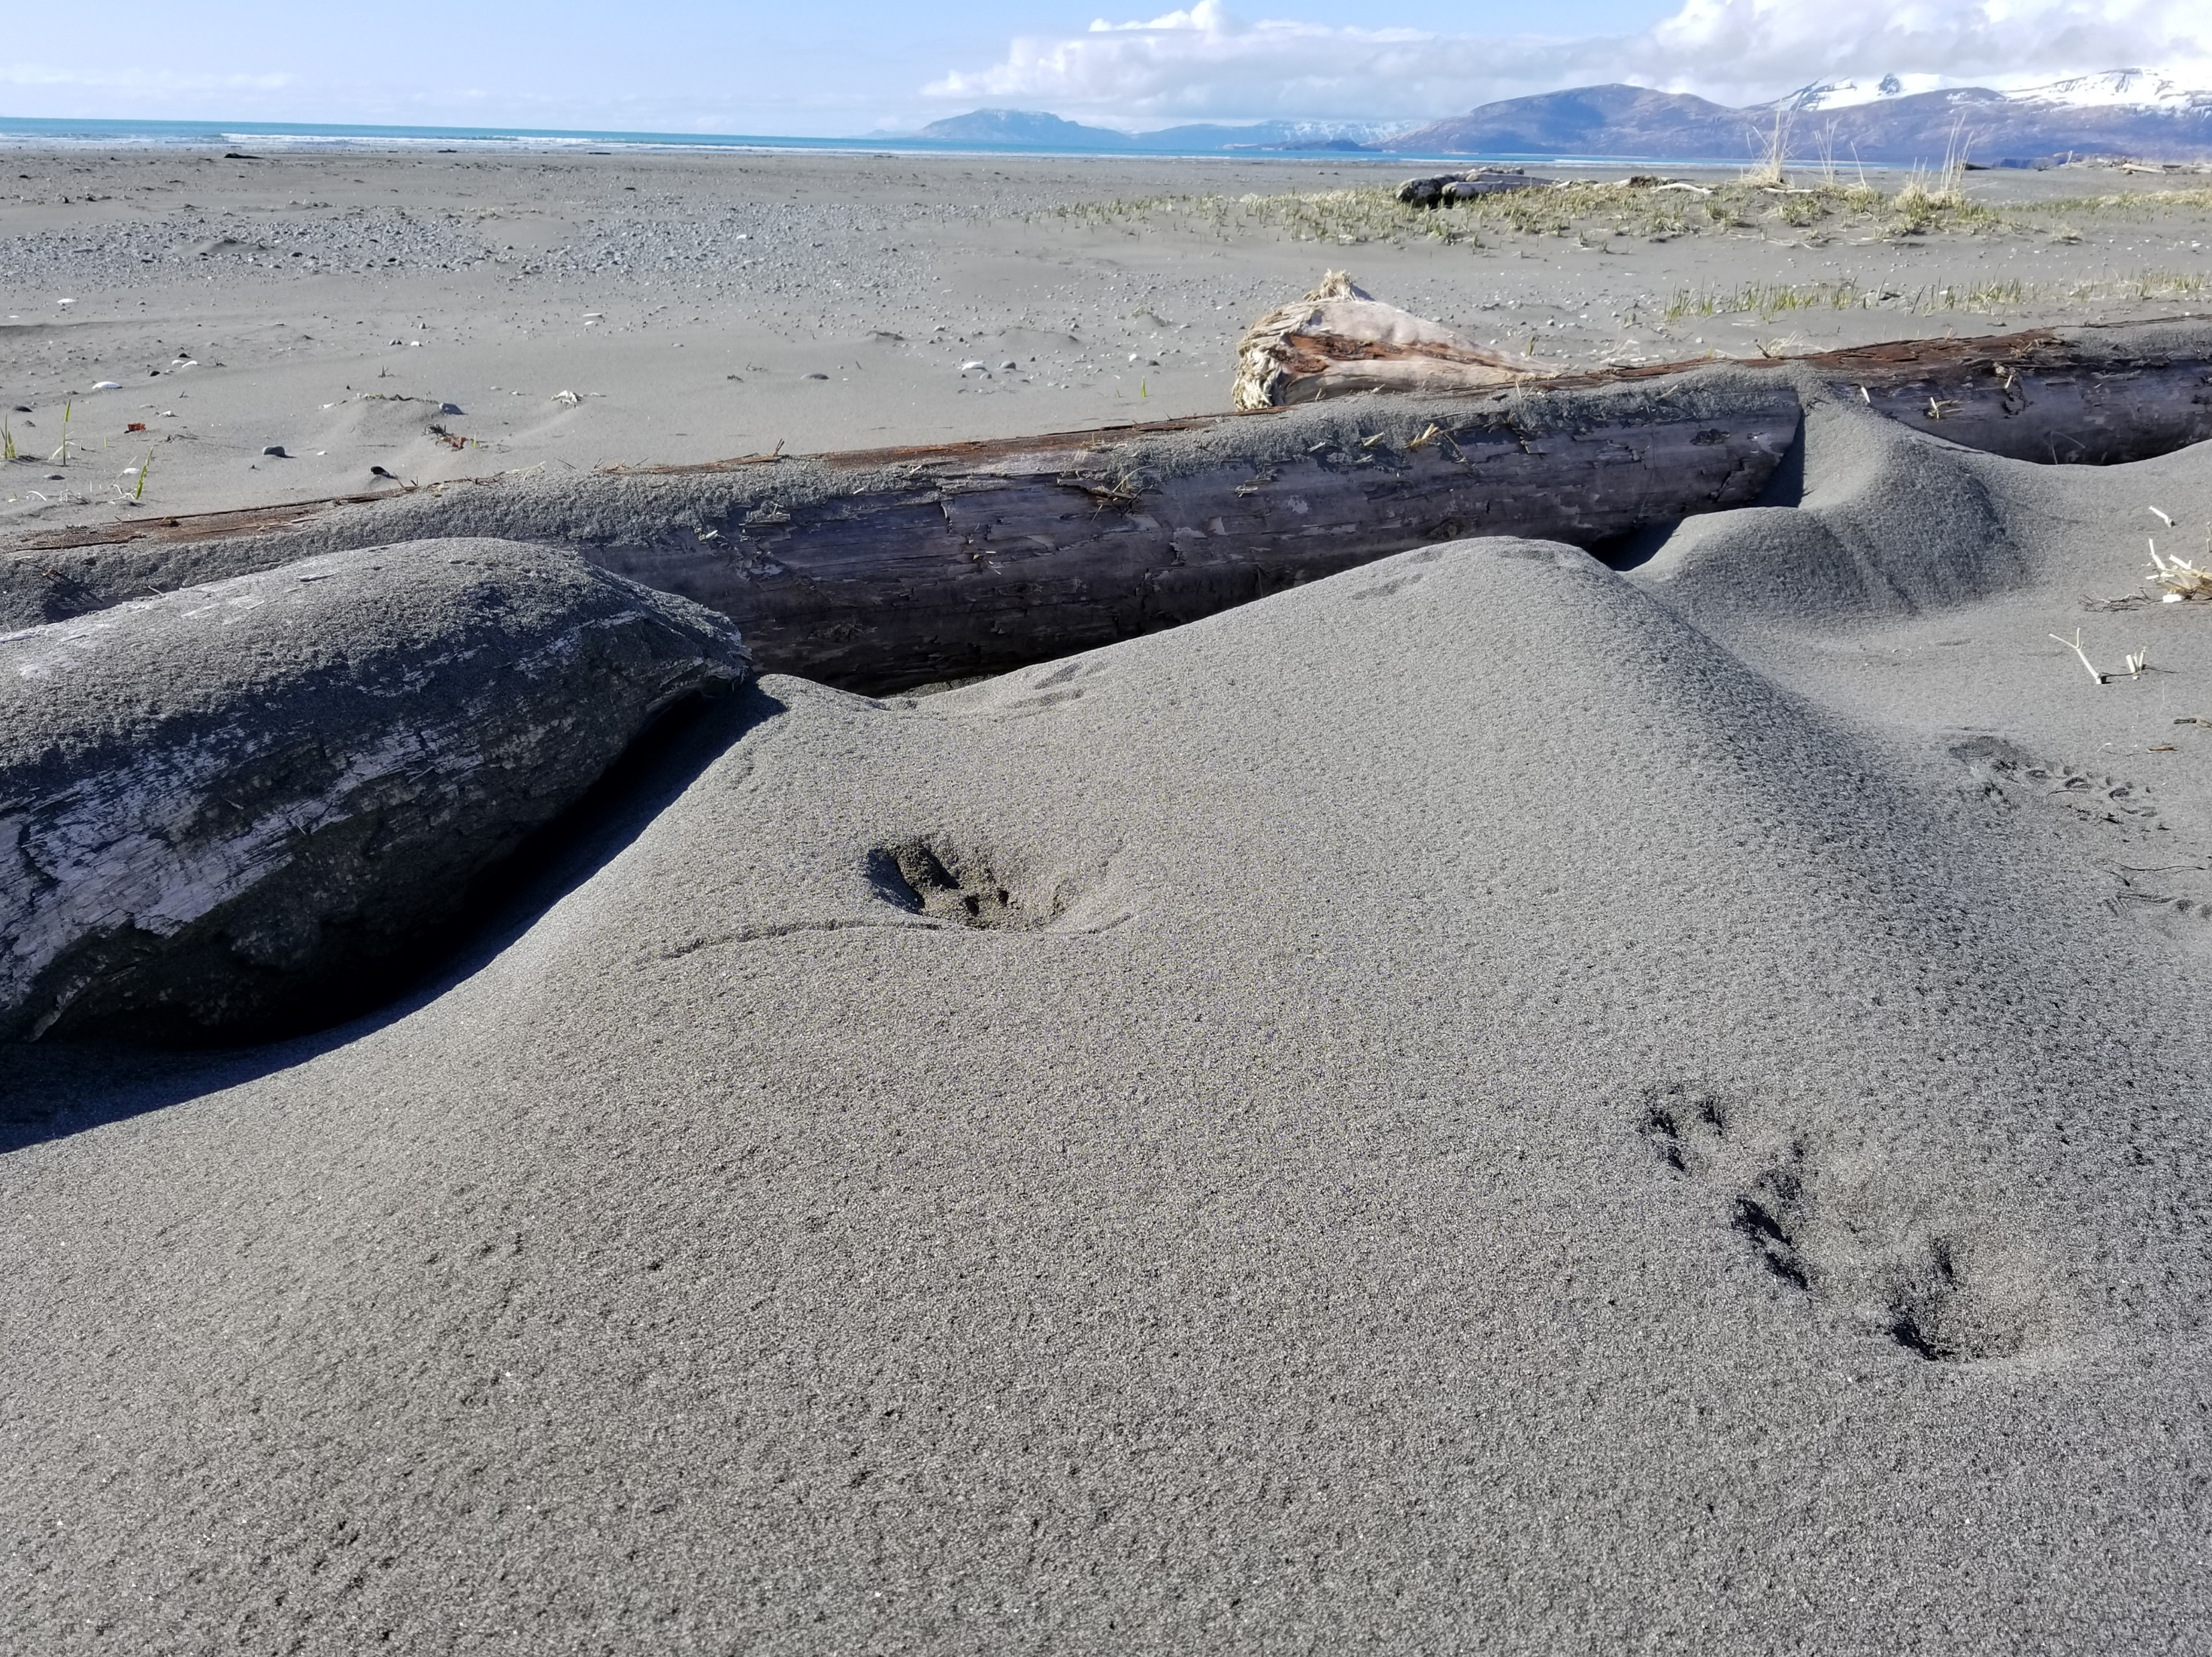
Katmai Wilderness, Alaska
Preserving Wilderness Character
A Multi-Agency Responsibility
Tim Devine, National Park Service
Wilderness Stewardship Division
Arthur Carhart National Wilderness Training Center
Erin Drake, National Park Service
Wilderness Stewardship Division
Communications & Outreach Specialist
Notes:
Tim
Introduce self and Erin introduce self
Follow along in your Preserving Wilderness Character Workbook
Objectives for the session are on the cover of the workbook
Page 3 is for notes

Slide 2
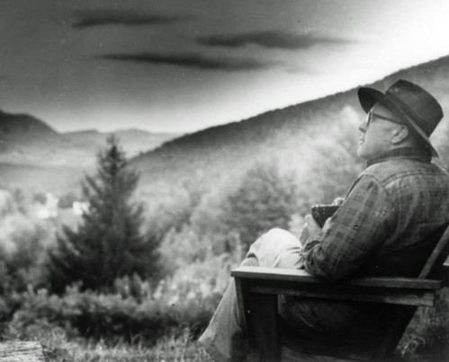
What is Wilderness Managed For?
“The purpose of the Wilderness Act is to ______ the _______ ______ of the areas to be included in the wilderness system, not to establish any particular use.”
Notes:
Tim
Who can fill in this quote?
Type in Chat
What are we mandated to preserve?

Slide 3
What is Wilderness Managed For?
“The purpose of the Wilderness Act is to preserve the wilderness character of the areas to be included in the wilderness system, not to establish any particular use.”
Notes:
Tim
Read the slide
Who said this? Type your answer in the chat box of who you think said it…

Slide 4
What is Wilderness Managed For?
“The purpose of the Wilderness Act is to preserve the wilderness character of the areas to be included in the wilderness system, not to establish any particular use.”
Howard Zahniser
Notes:
Tim
Howard Zahniser… primary author of the Wilderness Act… As you learned this morning

Slide 5
Why Wilderness Character?
Preservation of Wilderness Character
Importance is acknowledged within all Federal branches
Page 4
Notes:
Tim
Page 4 of Workbook
Preservation of wilderness Character is clearly identified as the core of wilderness stewardship by all three branches of government.

Slide 6
Why Wilderness Character?
Preservation of Wilderness Character
Importance is acknowledged within all Federal branches
ACT
Legislative Branch – Wilderness Act
Section 2(a) & 4(b)
Page 4
Notes:
Tim
Legislative Branch = Wilderness Act of 1964, Sections 2(a) & 4(b)
We’ll look at the mandate from the Wilderness Act in just a minute

Slide 7
It’s the law: Wilderness Act of 1964
ACT
“…shall be administered… so as to provide for…the preservation of their wilderness character…”
The Wilderness Act, Sec 2(a)
“…each agency administering any… wilderness shall be responsible for preserving the wilderness character…”
The Wilderness Act, Sec 4(b)
“…administer…to preserve its wilderness character…”
The Wilderness Act, Sec 4(b)
Page 4
Notes:
Tim
The Statement of Policy in Section 2(a) describes the overall goals for establishing wilderness, and this Section clearly states that the administering agencies shall preserve wilderness character.
There are two central reasons why wilderness character is important. The first, shown here, is that the Wilderness Act requires the agencies that administer wilderness to preserve the wilderness character of the area. In other words, preserving wilderness character is a legal requirement.
Then twice in Section 4(b) on the Use of Wilderness Area, we again see this clear statement.
Congress clearly intended a variety of uses in wilderness (“recreational, scenic, scientific, educational, conservation, and historical use”) and in allowing these uses, the agencies must also preserve the wilderness character of the area. Legal scholars point to this Section 4(b) statement as THE primary management mandate in the Wilderness Act, and Congress has reaffirmed that this is the central mandate to the agencies that administer wilderness.
The second reason why wilderness character is important is to understand why and how we take stewardship actions inside wilderness, in other words, to improve wilderness stewardship and bring it more closely inline with the statutory requirements and intent (or spirit) of the Wilderness Act.
The fourth place, not shown here, is in Section 4(d)(3) Special Provision about Mining. “… shall contain such reasonable stipulations… for the protection of the wilderness character of the land…”

Slide 8
Why Wilderness Character?
Preservation of Wilderness Character
Importance is acknowledged within all Federal branches
ACT
Legislative Branch – Wilderness Act
Section 2(a) & 4(b)
Executive Branch – Agency Policy & Guidance Manuals
Page 4
Notes:
Tim
Executive Branch = Agency Policy & Guidance Manuals

Slide 9
It’s our policy:
BLM: Manual 6340
“Manage and protect BLM wilderness areas in such a manner as to preserve wilderness character.”
FWS: Service Manual Part 610
“Administer refuge wilderness to conform with… preserving wilderness character”
USFS: Manual Chapter 2300
“Protect and perpetuate wilderness character”
NPS: Management Policies Chapter 6
“The purpose of wilderness in the national parks includes the preservation of wilderness character”
Page 4
Notes:
Tim
Links to agency policy on Wilderness Connect (you’ll learn about that on Tuesday) are on page 4 in your workbook.

Slide 10
Why Wilderness Character?
Preservation of Wilderness Character
Importance is acknowledged within all Federal branches
ACT
Legislative Branch – Wilderness Act
Section 2(a) & 4(b)
Executive Branch – Agency Policy & Guidance Manuals
Judicial Branch – Numerous Court Decisions
Page 4
Notes:
Tim
Judicial Branch = Numerous Court Decisions

Slide 11
It’s in the courts:
“…an improper evaluation of the wilderness character of the area….”
Barnes v. Babbitt (D. Ariz.) (2004)
“‘Natural conditions’…are part of the ‘wilderness character’ to be preserved.”
Wilderness Soc. v. USFWS (9th Cir. En banc) (2003)
“…that action degrades the wilderness character….”
Izaak Walton League v. Kimbell (D. Minn.) (2007)
“[The decision] is in direct contradiction of the mandate to preserve the wilderness character.”
OLYM Park Assoc. v. Mainella (West. D. WA) (2005)
Page 4
Notes:
Tim
There instances where the courts found the agencies were not preserving wilderness character by their actions.
No agency is left out.
Links to Case Law on Wilderness Connect are on page 4 in your workbook.

Slide 12
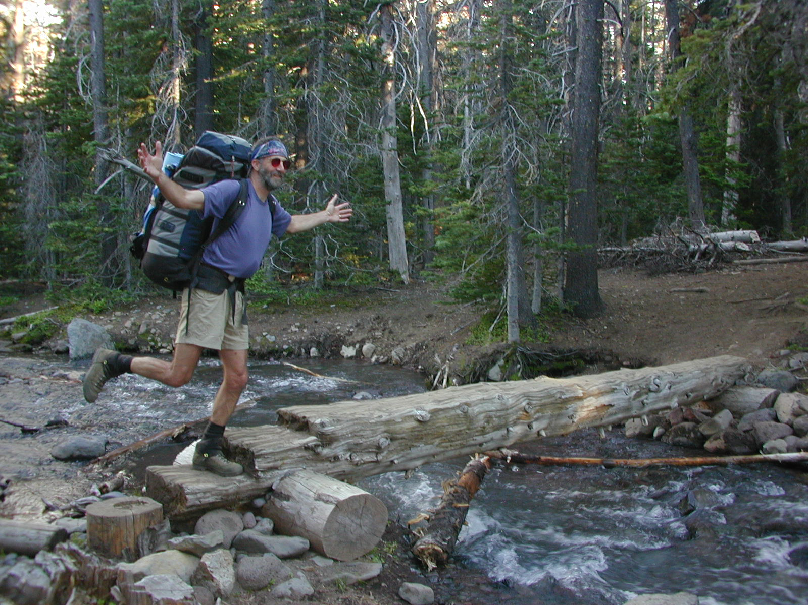
Wilderness Character
Page 5
Notes:
Tim
This is a wilderness character… I’m sure you all have run across a character like this in the wilderness, write their name or draw a picture of them on page 5, but this is not the type of wilderness character we are talking about today.

Slide 13
Wilderness Character
No specific definition in the Wilderness Act and no legislative history of Congressional discussion about the meaning of wilderness character
Notes:
Tim
The issue is especially poignant because Congress has not provided an explicit definition or other direction for defining wilderness character.
Since 2001, several different agency and interagency teams worked individually then together to define wilderness character. That interagency collaboration ultimately resulted in the definition we use today which is codified in “Keeping It Wild 2” which has been agreed upon by all four wilderness management agencies. Published in 2015, Keeping it Wild 2 updates the first Keeping it Wild and is based on about 7 years of field experience that showed the need for some clarifications to the first iteration.
Raise you hand in the icon menu if you’ve heard of KIW2

Slide 14
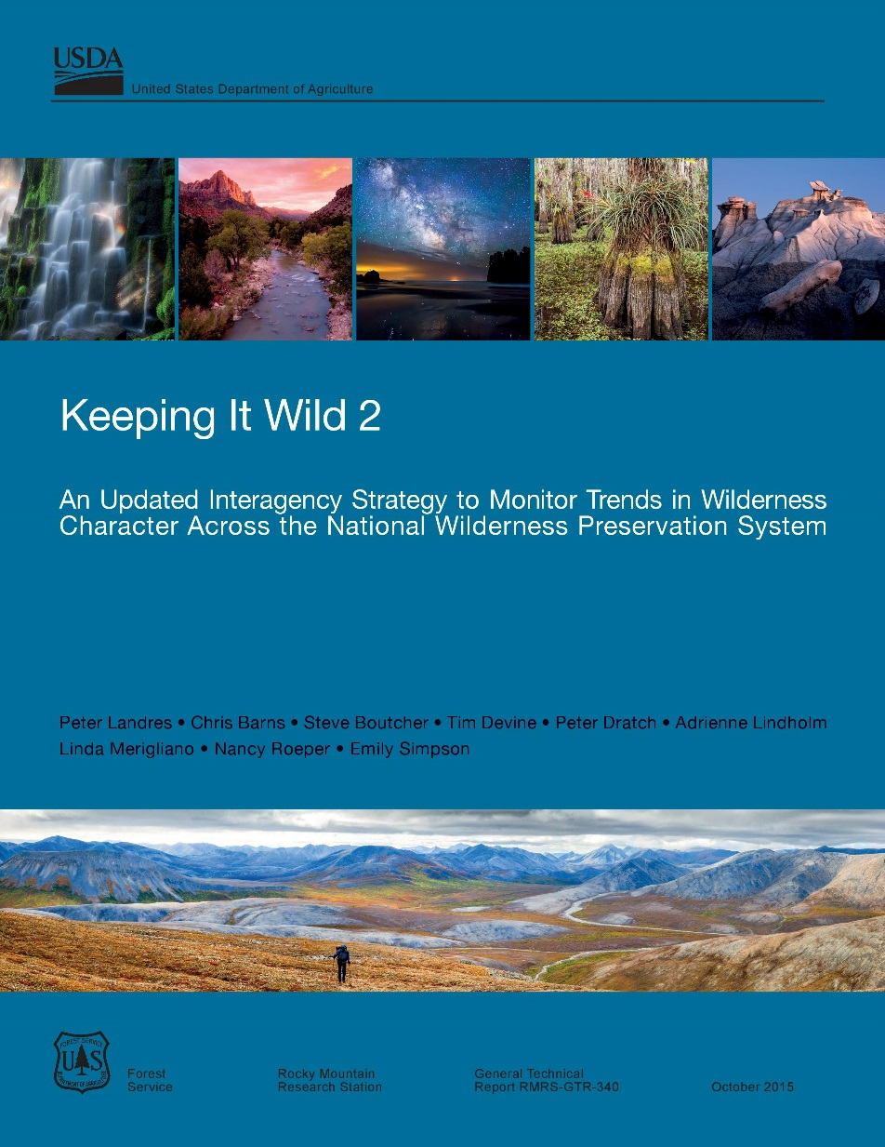
Wilderness Character
No specific definition in the Wilderness Act and no legislative history of Congressional discussion about the meaning of wilderness character
Notes:
Tim
“Keeping it Wild 2” not only defines Wilderness Character, but further identifies its qualities which we’ll talk about shortly.
Prior to this report, the definition of wilderness character was not uniform between agencies or units within agencies. This report provides a consistent and practical interpretation of wilderness character and conforms with the Wilderness Act.
The courts give a degree of deference to the agencies to interpret and implement statutes, where Congress has not clearly addressed them. Keeping it Wild 2 provides the level of detail needed to implement the Wilderness Act and conform with its mandate.
An electronic copy is available on Wilderness Connect. There’s a link at the end of the workbook on the Resources page 18

Slide 15
What is Wilderness Character?
Page 6
Notes:
Tim
So, what is that definition? The four wilderness managing agencies recognize that wilderness character is the intersection of…

Slide 16
What is Wilderness Character?
Biophysical
Environments
Page 6
Notes:
Tim
Fill in the blanks on page 6.
… the biophysical environments …
Details for the presenter's reference:
From Keeping it Wild 2. “Wilderness character is a holistic concept based on the interaction of
(1) biophysical environments primarily free from modern human manipulation and impact,

Slide 17
What is Wilderness Character?
Biophysical
Environments
Personal Experiences
Page 6
Notes:
Tim
… personal experiences …
Details for the presenter's reference:
From Keeping it Wild 2. “Wilderness character is a holistic concept based on the interaction of
(2) personal experiences in natural environments relatively free from the encumbrances and signs of modern society, and

Slide 18
What is Wilderness Character?
Biophysical
Environments
Personal Experiences
Symbolic Meanings
Page 6
Notes:
Tim
… and symbolic meanings …
Details for the presenter's reference:
From Keeping it Wild 2. “Wilderness character is a holistic concept based on the interaction of
(3) symbolic meanings of humility, restraint, and interdependence that inspire human connection with nature.

Slide 19
What is Wilderness Character?
Taken together, these tangible and intangible values define wilderness character and distinguish wilderness from all other lands.
Biophysical
Environments
Wilderness
Character
Personal Experiences
Symbolic Meanings
Page 6
Notes:
Tim
This intersection results in tangible and intangible aspects. The tangible aspects of wilderness character are identified in the Wilderness Act.
Details for the presenter's reference:
From Keeping it Wild 2. “Wilderness character is a holistic concept based on the interaction of
biophysical environments primarily free from modern human manipulation and impact,
personal experiences in natural environments relatively free from the encumbrances and signs of modern society, and
(3) symbolic meanings of humility, restraint, and interdependence that inspire human connection with nature.

Slide 20
Where did the authors of KIW2 find the qualities of wilderness character?
Merriam-Webster dictionary, 1916 edition
Wikipedia, 2001
Wilderness Act, 1964
Out of thin air, 2020
Notes:
Tim
Time for a poll…
Open poll
Correct answer = c
Merriam-Webster dictionary, 1916 edition
Wikipedia, 2001
Wilderness Act, 1964
Out of thin air, 2020

Slide 21
Where did the authors of KIW2 find the qualities of wilderness character?
Merriam-Webster dictionary, 1916 edition
Wikipedia, 2001
Wilderness Act, 1964
Out of thin air, 2020
Notes:
Tim
Review anwser
Correct answer = c
Merriam-Webster dictionary, 1916 edition
Wikipedia, 2001
Wilderness Act, 1964
Out of thin air, 2020

Slide 22
Wilderness Act of 1964
Section 2(c)
DEFINITION OF WILDERNESS: “A wilderness, in contrast with those areas where man and his own works dominate the landscape, is hereby recognized as an area where the earth and its community of life are untrammeled by man, where man himself is a visitor who does not remain. An area of wilderness is further defined to mean in this Act an area of undeveloped Federal land retaining its primeval character and influence, without permanent improvements or human habitation, which is protected and managed so as to preserve its natural conditions and which (1) generally appears to have been affected primarily by the forces of nature, with the imprint of man's work substantially unnoticeable; (2) has outstanding opportunities for solitude or a primitive and unconfined type of recreation; (3) has at least five thousand acres of land or is of sufficient size as to make practicable its preservation and use in an unimpaired condition; and (4) may also contain ecological, geological, or other features of scientific, educational, scenic, or historical value ...”
Notes:
Tim
Where do we find the qualities of WC? You need look no further than the definition of Wilderness in Section 2(c) of the Wilderness Act of 1964.
Highlighted here are the five tangible qualities of wilderness character you hear about most often…
Untrammeled
Undeveloped
Natural
Outstanding Opportunities for solitude or a primitive and unconfined type of recreation
And…
Other Features of Value

Slide 23
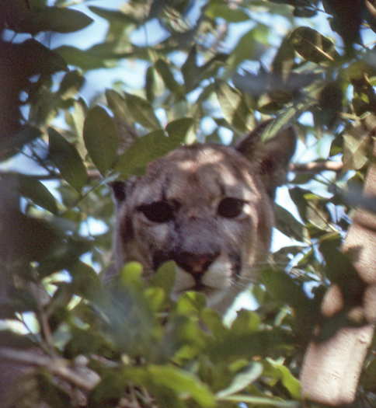
Qualities of Wilderness Character
Untrammeled
Natural
Undeveloped
Outstanding Opportunities
Other Features of Value
Page 7
Notes:
Tim
Fill in the blanks in your workbook, Page 7
These 5 qualities make up the tangible things we monitor to understand the status/trend in Wilderness Character which Erin is going to talk about in a little bit.

Slide 24
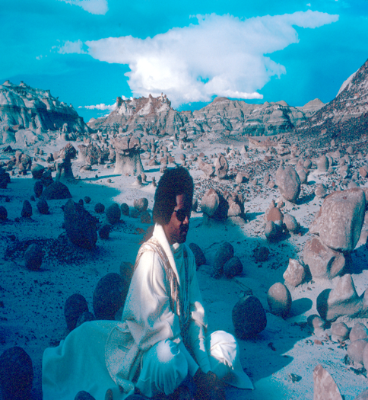
Qualities of Wilderness Character
Untrammeled
Natural
Undeveloped
Outstanding Opportunities
Other Features of Value
Intangible
Page 7
Notes:
Tim
Fill in the blanks in your workbook, Page 7
Yet we can’t forget the intangible qualities, these aren’t specifically called out in the Wilderness Act, but are important to identify. They are not impossible, but are harder to monitor.
These qualities are what we are mandated to preserve and protect.
Let’s take a closer look at each of these qualities.
Erin… take it away

Slide 25
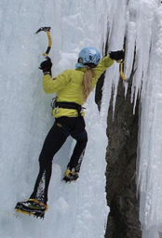
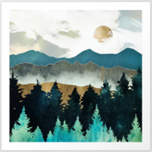
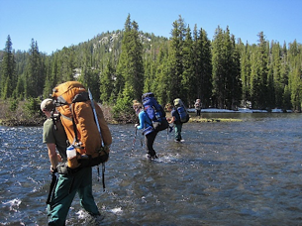
Risk
Reflection
Inspiration
Challenge
Page 8
Notes:
Erin
Use Page 8 in your workbook to take notes
Like the definition of WC states, wilderness is in part defined by its distinct and unique experiential and symbolic meanings.
Deeply personal, the things that connect us to wilderness are often not physically present, i.e., they are intangible, like a place that invites a sense of adventure, a feeling of profound inspiration, or an ability to more deeply connect with people you care about.
These intangible qualities are often the aspects of wilderness that are most compelling to each of us and at the same time may be difficult to articulate.
Because intangible qualities are subjective and may differ from person to person, we as managers should strive to ensure we're providing enough space for discussion to understand the kinds of intangible qualities that may be related to your particular wilderness area. This can be done through conversations and reflection with staff, feedback provided by visitors, or through the use of more formal qualitative surveys.

Slide 26
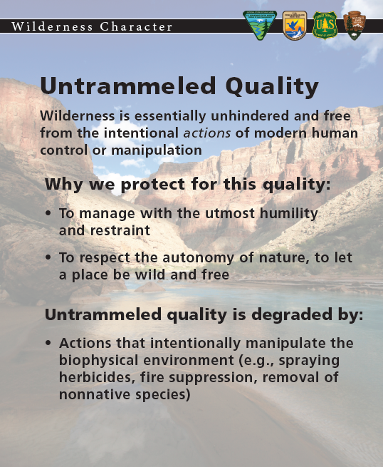
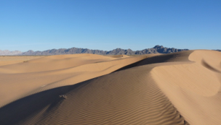
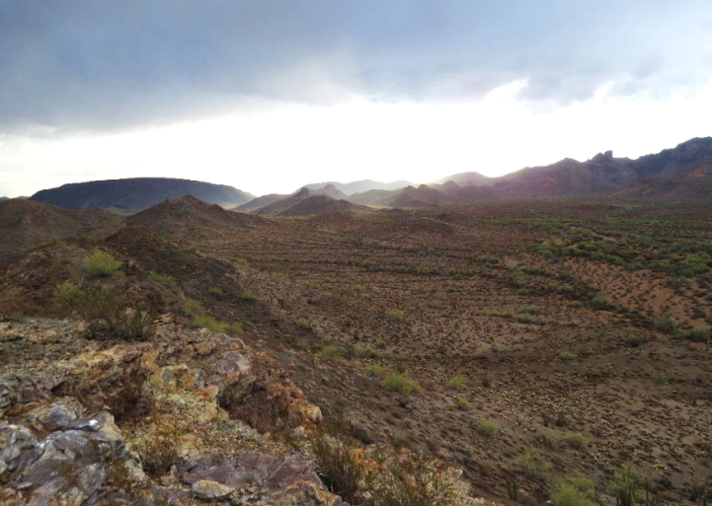
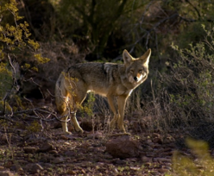
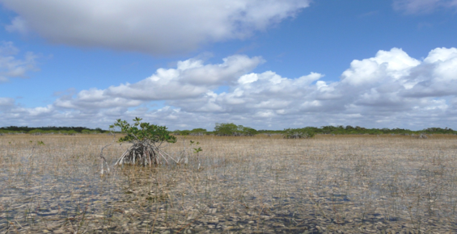
Unmanipulated
Free
Uncontrolled
Wild
Page 8
Notes:
Erin
Page 8 in your workbook for notes
Read quality def from slide.
It's important to note here that this quality is concerned with actions that are intentionally manipulating the biophysical environment.
The Untrammeled Quality recognizes the importance of people co-existing with our planet, where people practice humility and are very selective and thoughtful about actions we take that might interfere with the rest of the natural world.
The Untrammeled Quality is, according to many wilderness scholars, the primary ideal for wilderness. Although the word “untrammeled” is not common, Howard Zahniser, the primary author of the Wilderness Act, used the word “untrammeled” because it was the exact word to convey the importance of keeping wilderness free from manipulation and control. Whereas a trammel is something that restricts free play, motion, and fluidity, something that is untrammeled promotes free will and uninhibited flow.
It’s interesting to note that Howard didn’t come up with “untrammeled” himself. Pauline “Polly” Dyer a champion of NW conservation and the protection of Olympic and North Cascades National Parks suggested Howard use the phrase “untrammeled by man”. She used it so effectively to describe the imperiled beaches in Olympic National Park in the mid 1950s when there was a proposal to build a road along the Olympic coast. She expressed the coast and beaches should be free, uncontrolled, wild… untrammeled…

Slide 27
Unmanipulated
Free
Uncontrolled
Wild
Type your answers in the Chat Box
Page 8
Notes:
Erin
Page 8 in your workbook for notes
This quality prompts managers to pause before taking action, really examining if our actions are beneficial to the wildness of this place. Preserving the Untrammeled Quality can sometimes mean not interfering – not taking action – but instead taking a pause, and fully considering the impacts and tradeoffs before getting involved.
Let's think about how this quality relates to our work. What might be some examples of management actions we take that would degrade or threaten this quality? Type your thought in the chat box.
Read off several then go to next slide.

Slide 28
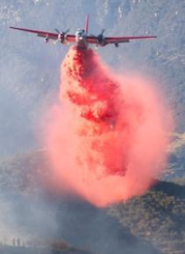
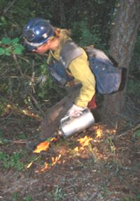
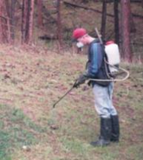
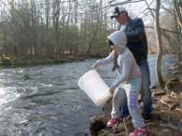
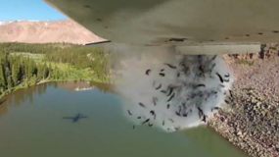
Natural Processes
Predator Prey
Relationship
Vegetation
Management
Public
Agency
Page 8
Notes:
Erin
Any action that would “intentionally” manipulate "the earth and its community of life" as the WA puts it, is a trammel. These intentional actions must be linked to the biophysical environment.
Our actions to control natural processes such as fire suppression or putting fire on the land, interfering with the predator/prey relationships, spraying for invasive species (yes, sometimes there may be a good reason to trammel), stocking fish in historically fishless lakes by our agency or the illegally by the public. I’m sure you can think of other actions we sometimes take that control or manipulate.
We use the word “modern” in this statement to clearly separate the past (that is, prior to wilderness designation) effects of native or indigenous people, which are an important part of wilderness, from the effects of modern people.
Things that can degrade this quality = a trammeling
Removal of invasive species, or the introduction of a native/indigenous species
It’s important to note that not all actions taken in wilderness constitute a trammeling. Things that do not degrade this quality, which are commonly confused as a trammeling action = ranger patrols, interpretive hikes, stream gauges, etc.

Slide 29
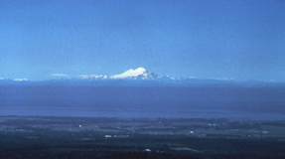
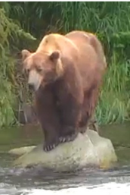
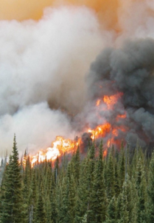
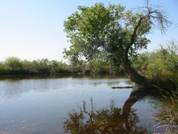
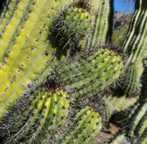
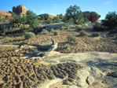
Air
Ecological
processes
Wildlife
Water
Soil
Vegetation
Page 9
Notes:
Erin
Page 9 in your workbook for notes
Read def of quality from slide.
The Natural Quality recognizes the importance of healthy, intact ecosystems and challenges us, as wilderness managers, to limit our negative effects on the functionality of these systems. Under this quality, human-caused negative impacts things like air quality, indigenous plant and animal species, and larger scale ecological process need to be addressed to help improve the Natural Quality of wilderness character.
You might be thinking "Wait. Didn't we just say that we need to be selective about when we intervene and take action to protect the Untrammeled Quality?"
Yes, you're right! The Untrammeled Quality focuses on the impact of our intervention and manipulation by way of intentional actions we take – using a selective, thoughtful, and even light hand when actively managing our wilderness lands. The Natural Quality is the complementary, and at times conflicting, other side of this coin, recognizing that people can intentionally and unintentionally have lasting negative effects on the rest of the natural world. Through this quality, we are responsible for examining these effects and considering ways we can help remedy their impacts.

Slide 30
Air
Ecological
processes
Wildlife
Water
Type your answers in the Chat Box
Soil
Vegetation
Page 9
Notes:
Erin
Page 9 in your workbook for notes
What are some examples of conditions that would degrade this quality? Type your thought in the chat box.
Read off several then go to next slide.

Slide 31
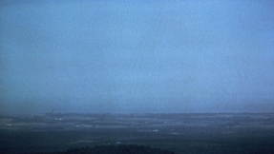
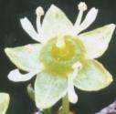
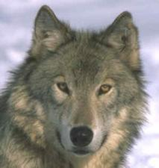
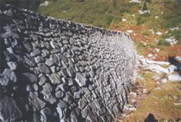
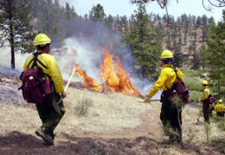
Pollution
Non-native
species
Extirpation
Alteration of ecological processes
Page 9
Notes:
Erin
As you can see, the Untrammeled and Natural qualities may appear to be in conflict sometimes. It’s not one vs the other. We have a unique and challenging management taks to holistically address wilderness character preservation, including achieving a reasonable and practical balance between the Untrammeled and Natural Qualities. This balance often means acknowledging tradeoffs, and being prepared for what is gained or lost in this balance between qualities.

Slide 32
Which of these statements about the Untrammeled and Natural Qualities is true?
Untrammeled = free from effects of modern civilization, Natural = intentional actions that manipulate the earth and its community of life (biophysical environment)
Untrammeled = not trampled/stomped on, Natural = pristine
Untrammeled = intentional actions that manipulate the earth and its community of life (biophysical environment),
Natural = free from effects of modern civilization
Untrammeled = restrained, Natural = ecosystem
Notes:
Erin
Just so we’re clear on the difference between Untrammeled and Natural answer this question…
Open the poll – WC2
You can x out of the poll panel (upper right corner) to see the chat and/or participant list

Slide 33
Which of these statements about the Untrammeled and Natural Qualities is true?
Untrammeled = free from effects of modern civilization, Natural = intentional actions that manipulate the earth and its community of life (biophysical environment)
Untrammeled = not trampled/stomped on, Natural = pristine
Untrammeled = intentional actions that manipulate the earth and its community of life (biophysical environment),
Natural = free from effects of modern civilization
Untrammeled = restrained, Natural = ecosystem
Notes:
Erin
Review answer
Correct answer = c
Back to Tim to look at the remaining qualities…

Slide 34
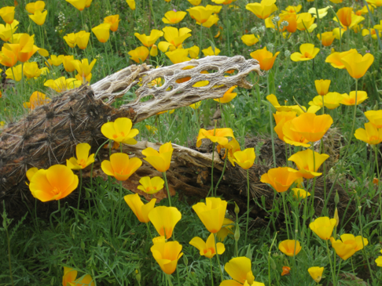
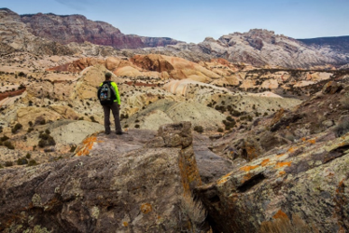
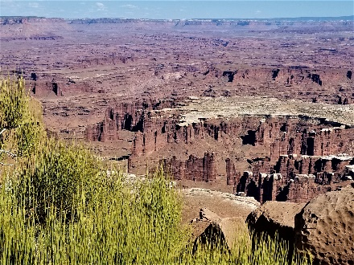
Primeval
character
Feeling a part of…
No permanent improvement
Page 9
Notes:
Tim
Still on Page 9 in your workbook for notes
Read def of quality from slide.
Undeveloped… Pretty self describing don’t you think? Without permanent improvement or modern human occupation.
Remember what the WA says… “to assure that an increasing population, accompanied by expanding settlement and growing mechanization does not occupy and modify all areas…”
This allows people to feel a part of, not apart from, the natural environment.

Slide 35
Primeval
character
Feeling a part of…
Type your answers in the Chat Box
No permanent improvement
Page 9
Notes:
Tim
Still on Page 9 in your workbook for notes
What might degrade this quality? Type your thought in the chat box.
Read off several then go to next slide.

Slide 36
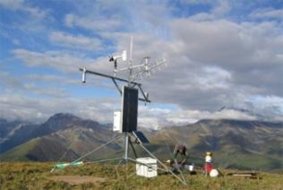
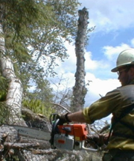
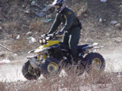
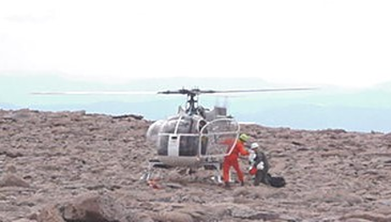
Installations
Structures
Motors
Vehicles/Aircraft
Mechanical
transport
Page 9
Notes:
Tim
Notice Undeveloped is about being degraded by “non-recreational” structures and installations e.g. research instruments, fire lookout/ranger cabins. Recreational structures and installations are considered in the quality we’ll talk about next.
Also the use of motorized equipment e.g. chainsaws, and motor vehicles or mechanical transport degrade this quality… do those sound familiar? They should… they’re prohibitions listed in the WA, to guard against “growing mechanization” as the Act says.

Slide 37
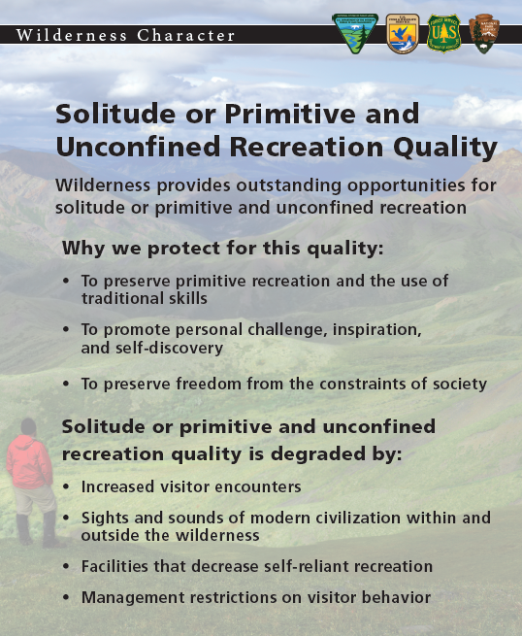
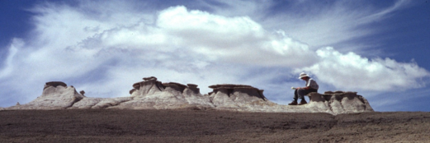
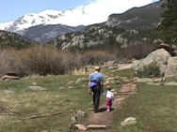
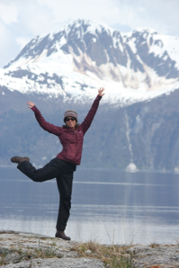
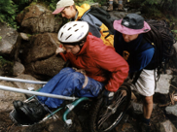
Inspiration
Discovery
Freedom
Challenge
Page 10
Notes:
Tim
Now on Page 10 in your workbook for notes
The next quality we’ll look at is Solitude or a Primitive and Unconfined Type of Recreation… otherwise know as Outstanding Opportunities…
Read def of quality from slide.
This is where we preserve opportunities for solitude, primitive recreation and promote self reliance.
Note the use of the words “outstanding opportunities”… solitude or these types of recreation may not exist in all parts of your wilderness.

Slide 38
Inspiration
Discovery
Type your answers in the Chat Box
Freedom
Challenge
Page 10
Notes:
Tim
Now on Page 10 in your workbook for notes
What are some things take that would degrade this quality? Type your thought in the chat box.
Read off several then go to next slide.

Slide 39
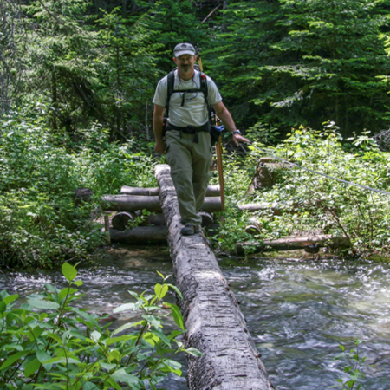
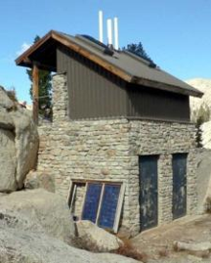
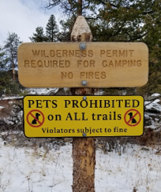
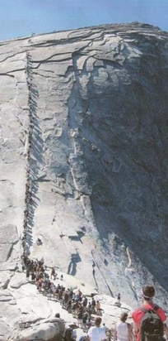
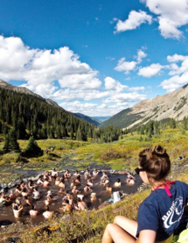
Facilities
Restrictions
Encounters
Page 10
Notes:
Tim
Facilities that decrease self reliance e.g., two story outhouses or bridges, increased visitor encounters like on the cable route of Half Dome in Yosemite NP or Conundrum Hot Springs in the Forest Service Maroon Bells-Snowmass Wilderness in Colorado, or restrictions we put in place like permits, designated campsite, staying on the trails, don’t do this, don’t do that… all degrade this quality.

Slide 40
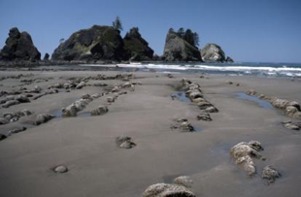
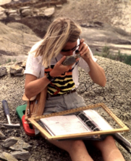
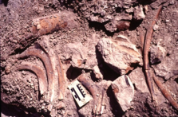
Scenic
Scientific
Cultural
Page 10
Notes:
Tim
The last quality that we’ll talk about is Other Features of Value.
Read def of quality from slide.
These values may be of scientific, educational, scenic or historic nature. National Natural Landscapes, Paleo, and Cultural resources come to mind. Things that make your wilderness special and stand out. They may be identified in the enabling legislation of your wilderness or in a wilderness character narrative.

Slide 41
Scenic
Scientific
Type your answers in the Chat Box
Cultural
Page 10
Notes:
Tim
How might these values be degraded? Type your thought in the chat box.
Read off several then go to next slide.

Slide 42
Vandalism
Moldering/Neglect
Theft
Page 10
Notes:
Tim
What these “features” are, dictate how they are degraded… that could be vandalism to rock art, or loss of a historic structure, or outright theft of unique objects.

Slide 43
Qualities of Wilderness Character
Untrammeled
Natural
Undeveloped
Outstanding Opportunities
Other Features of Value
Intangible
Page 7
Notes:
Tim
So to quickly recap… the qualities of WC are… Refer to page 7 in workbook
Untrammeled
Undeveloped
Natural
Outstanding Opportunities for solitude or a primitive and unconfined type of recreation
Other Features of Value
And
Don’t’ forget the Intangibles…

Slide 44
Wilderness character is a holistic concept based on…
Personal Opinions
Symbolic Idols
Symbolic Meanings
Biophysical
Environments
Personal Experiences
Alien Experiences
Urban
Environments
Notes:
Tim
Using your annotation tools… Put an “X” on what’s NOT part of the holistic definition of wilderness character, or a “CIRCLE” around what is.
Biophysical Environments
Personal Experiences
Symbolic Meanings

Slide 45
A holistic concept
Biophysical
Environments
Wilderness
Character
Personal Experiences
Symbolic Meanings
Page 6
Notes:
Tim
Refer to page 6 in workbook
From Keeping it Wild 2. “Wilderness character is a holistic concept based on the interaction of
biophysical environments primarily free from modern human manipulation and impact,
personal experiences in natural environments relatively free from the encumbrances and signs of modern society, and
(3) symbolic meanings of humility, restraint, and interdependence that inspire human connection with nature.

Slide 46
Lunch Time
Please return ready to go at 1:30 pm MST

Slide 47
Lunch is over…
Welcome Back…
Let’s get started again!

Slide 48
Untrammeled
Intangible
Undeveloped
Other Features
Of Value
What qualities are missing?
Notes:
Tim
What are the missing qualities? Type in Chat

Slide 49
Untrammeled
Intangible
Natural
Undeveloped
Outstanding
Opportunities
Other Features
Of Value
Notes:
Tim
Natural and Outstanding Opportunities

Slide 50
Conflicting Qualities?
Addressing a threat to one quality may yield a new threat to another
Notes:
Tim
In considering the qualities of wilderness character, it becomes apparent that there can be complex interactions between qualities. Addressing a threat to one quality may result in a new threat to another quality.

Slide 51
Conflicting Qualities?
Addressing a threat to one quality may yield a new threat to another
A quality can be improved or degraded by management action or inaction
Notes:
Tim
It’s not very simple to when a management decision to take action or to refrain action can at the same time improve one quality while degrading another.
Let’s take a look at how these qualities interact with each other

Slide 52
Prescribed burning
•
Affected Qualities of
Wilderness Character?
Untrammeled
Natural
Undeveloped
Outstanding Opportunities
Other Features of Value
Positively
Negatively
USFS & BLM
Page 11
Notes:
Tim
Now that we’ve gone over the qualities let’s go thru some management actions and how they would affect each quality of wilderness character… We’ll start with prescribed burning.
Ask the USFS attendees to participate – identify the qualities of wilderness character affected by the following activities. There can be positive and negative effects to multiple qualities.
USFS - Use your Line Annotation Tool to draw at line from the quality to Positively or Negatively or neither, or type answers in the chat box.
Everyone can do this on Page 11
How would prescribed burning be considered in this framework of wilderness character?
Answer:
Prescribed burning degrades the Untrammeled Quality because it is manipulating “the earth and its community of life” even if it is done to restore natural fire regime.
Prescribed burning may benefit the Natural Quality if it is done to restore natural fire regimes.
If the prescribed fire is accomplished by the use of aircraft, it degrades the Undeveloped Quality.
Photo: Chiricahua National Monument Wilderness

Slide 53
Radio collars
•
Affected Qualities of
Wilderness Character?
Untrammeled
Natural
Undeveloped
Outstanding Opportunities
Other Features of Value
Positively
Negatively
NPS & USFWS
Page 12
Notes:
Tim
Let’s now look at Radio collaring wildlife…
Ask the USFWS and BLM attendees to participate – identify the qualities of wilderness character affected by the following activities. There can be positive and negative effects to multiple qualities.
USFWS/BLM - Use your Line Annotation Tool to draw at line from the quality to Positively or Negatively or neither, or type answers in the chat box.
Everyone can do this on Page 12
How would placing radio collars on wildlife be considered in this framework of wilderness character?
Answer:
It may be necessary to study the moose in order to provide for the protection of the Natural Quality.
The presence of the radio collars is an installation, even though it is a mobile one, and therefore degrades the Undeveloped Quality.
Encountering a moose with a collar on it, degrades the sense of remoteness and therefore the Opportunity for Solitude.
The capture of the moose might have included the use of motor vehicles, degrading the Undeveloped Quality.
On Page 13 there is another scenario for you to try on your own.
Going to send it back to Erin now.
Photo: Washington state (not inside wilderness), James Goerz

Slide 54
All wilderness areas are created equal
Notes:
Erin
Here’s a statement… think about it for a bit… is this statement true or false?

Slide 55
All wilderness areas are created equal
True False
Notes:
Erin
Answer this statement by using your Text Annotation Tool and typing a “T” under True or an “F” under False.
[or put a check mark or “X” in either the True or False column]
Correct answer = False, in the sense that wilderness areas are not identical and some areas may have a particular wilderness character quality more intact than another area. I’d also note that while wilderness areas are not equal in this sense, all wilderness are valuable and important as we celebrate the spectrum of values, experiences, and resources protected in our National Wilderness Preservation System.

Slide 56
Wilderness Character
State of wilderness character at the time of designation
Less degraded
Wilderness A
Wilderness Character
Wilderness B
More degraded
Wilderness C
Less
More
Modern Human Influence
Page 14
Notes:
Erin
We’re on page 14 of the Workbook
Before we get into the principles of the monitoring framework, we need to account for the realities of each unit of the NWPS
Every wilderness will come into the NWPS at a different point; each has a different condition of wilderness character.
This simplified scale shows that as human influence increases, wilderness character is degraded. Some wilderness areas are less degraded, some more degraded. The examples depict the state of wilderness character for three hypothetical wilderness areas at the time of designation.
Using your annotation tool, mark where you think your wilderness falls on this line.
The intention of WCM is not to compare wilderness character in one wilderness to wilderness character in another wilderness. The intention is to understand how wilderness areas are changing. Every wilderness starts at a different state of wilderness character. Every wilderness has it’s own threats. Stewardship cannot require every wilderness into the same condition. But stewardship can influence how a wilderness may be moving on this graph.

Slide 57
Wilderness Character Monitoring
Helps us tangibly track changes in wilderness character over time
Credible information and data to inform future decision-making
Management accountability for this preservation mandate
Interagency consistency for NPS, BLM, USFWS, and USFS
Page 15
Notes:
Erin
Workbook: Use the Word Bank at the bottom of Page 15 to fill in the blanks
Read slide.
Raise your hand if you have started WC monitoring at your wilderness unit or, for those not working at wilderness units, have you assisted/participated in this process?

Slide 58
Wilderness Character Monitoring Structure
Wilderness Character
Qualities
Consistent across National Wilderness Preservation System
Monitoring Questions
Indicators
Measures
Relevant to individual wilderness
Page 15
Notes:
Erin
Within this hierarchical wilderness character monitoring framework, the definition of wilderness character, qualities, monitoring questions, and indicators are all nationally consistent, as derived from the interagency Keeping It Wild 2 publication from 2015, and so do not change from wilderness to wilderness.
Monitoring Questions
Example from the Undeveloped Quality: What are the trends in mechanization?
Indicator
Undeveloped Example: Use of motor vehicles, motorized equipment, or mechanical transport.
Measures – requirements vary by agency
The measures are intended to be locally relevant by allowing unit flexibility which may be necessary to make the monitoring protocol applicable for every wilderness. Each agency handles measures a little differently. We won’t address what measures to use in this training, because agency-specific training best addresses measure selection and development.
This balance between local relevance and national consistency allows WCM to be useful on small and large scales.
Workbook: Use the Word Bank at the bottom of Page 15 to fill in the blanks

Slide 59
Wilderness Character Monitoring
Reference interagency and agency framework(s) and guidance
Select measures
Conduct baseline assessment
Conduct ongoing monitoring
Assess trend in wilderness character over time
Notes:
Erin
Recognizing there is some agency-to-agency variability for WCM, this slide does showcase the general steps for WCM that all agencies would do.
Read steps.

Slide 60
Wilderness Character Monitoring
Agency Monitoring Technical Guides
Notes:
Erin
All agencies have or are working on technical guides with detailed information on how to conduct monitoring, how to apply KIW2 and specific instructions on picking measures. Not all agencies do it the same way, as we see variations in how WCM is administered and who does the actual monitoring, the process to create measures, and even the degree of proscription assigned to measure protocol.

Slide 61
Integrating Wilderness Character
Tangible
Intangible
Tangible and practical aspects of wilderness character arising from the Wilderness Act definition
Spiritual, symbolic, ethical, philosophical, and other intangible aspects of wilderness character
Page 16
Notes:
Erin
Take notes on page 16
In earlier discussions we talked about Five tangible qualities of wilderness character, which would fall on the left side of this graphic. There are also intangible qualities as well (right side). The framework for wilderness character monitoring is focused on the left side, as intangible qualities, while not impossible to address in monitoring, are more difficult and may be better suited for other wilderness character preservation efforts, like the development of the Wilderness Character Narrative. And again, we know that at minimum, when the tangible qualities are preserved, the intangible qualities will be preserved as well. So, let’s think about ways we can integrate wilderness character at our wilderness stewardship. We’ll talk more about this and get into specifics on Friday.
Workbook: If you have ideas about ways to integrate wilderness character into your work, feel free to list them on page 16.
What are some ways to apply WC into your day-to-day operations/management? Write in the chat box.
Staff & Partners Orientation and Training
Interpretation & Education
Communications & Outreach
Field Presence (Wilderness Ambassadors)
Adhere to NPS policy
Decisions = Include Interdisciplinary Engagement
Actions = Minimum Requirements Necessary
The application of the tangible qualities of wilderness character goes into the management side of things, including monitoring. Those intangible qualities are applied to other things we do, such as communicating with the public. But, again, we know that when we preserve the tangible qualities, the intangible qualities are also protected. The Wilderness Character Monitoring Framework is focused on these tangible qualities, and that will be our focus as we go through the structure of the framework.

Slide 62
Notes:
Erin
Here are some examples of ways to integrate wilderness character into your more regular operations. It’s a separate handout you received in your packet.

Slide 63
Minimum Requirements Analysis
Step 1
Wilderness Character
Is action necessary to preserve one or more of the five qualities of wilderness character?
Notes:
Erin
A classic example of integrating wilderness character into operations = the Minimum Requirements Analysis using the interagency MRDG.
The tangible qualities of WC are examined in both steps of the MRDG.
In Step 1 you ask… ”Is action necessary to preserve one or more of the five tangible qualities of wilderness character?”

Slide 64
Minimum Requirements Analysis
Step 1
Wilderness Character
Is action necessary to preserve one or more of the five qualities of wilderness character?
Step 2
Wilderness Character
What is the effect of each component activity on the qualities of wilderness character? What mitigation measures will be taken?
Notes:
Erin
In Step 2 you ask… “What is the effect of each component activity on the qualities of wilderness character? What mitigation measures will be taken?
The MRDG helps us to make the decision that preserves wilderness character to the greatest degree by minimizing impacts.
Back to Tim for a wrap of this session on wilderness character.

Slide 65
Wilderness Stewardship
Page 17
Notes:
Tim
Joint down your final thoughts about wilderness character on Page 17
Thanks Erin… So, to wrap things up… As much as we’d like it to be, wilderness stewardship is rarely black and white…

Slide 66
Wilderness Stewardship
Page 17
Notes:
Tim
There’s a lot of grey. That's where making informed, well thought out decisions come into play.

Slide 67
Wilderness Stewardship
Page 17
Notes:
Tim
Wilderness stewardship is not really a balancing act, one quality vs another, but what do you gain and what do you loose, or in other words, what would be improved and what would be degraded for each of the qualities of wilderness character when you take an action. Depending on the action the impacts to the qualities may being in conflict.
You must consider all improvements and degradations cumulatively to understand the full effect to wilderness character. Remember, Wilderness is a single resource, and the central mandate is to preserve wilderness character, not a single quality.

Slide 68
Wilderness Stewardship
DAMNED if you do
DAMNED if you don’t
Page 17
Notes:
Tim
You may feel like it’s a damned if you do, damned if you don’t situation. But the better you understand what degrades and what enhances the qualities of wilderness character, the tradeoffs, the long or short-term effects, one and done or reoccurring actions, etc…

Slide 69
Wilderness Stewardship
Damn!
Preserve Wilderness Character!!!
Wrong
Decision
Page 17
Notes:
Tim
… the light bulb will come on and …
the better you’ll be able to make the right decision that will help preserve the wilderness character of your area overall.

Slide 70
Cape Romain Wilderness, South Carolina
For more information
visit Wilderness Connect:
www.wilderness.net/character
Page 18
Notes:
Tim
For more information visit the WC toolbox on Wilderness Connect and watch for new online course next spring, which is in development now.
Cape Romain Wilderness, South Carolina
There are additional links to resources on Page 18

Slide 71
Questions?
Notes:
Tim and Erin
Questions?

